Slide 1
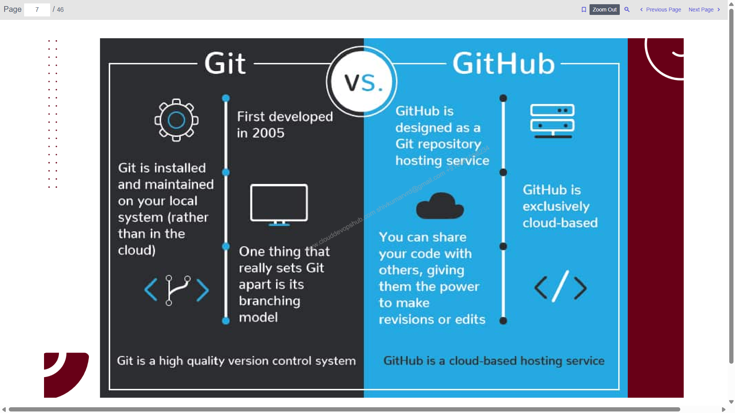

Slide 2
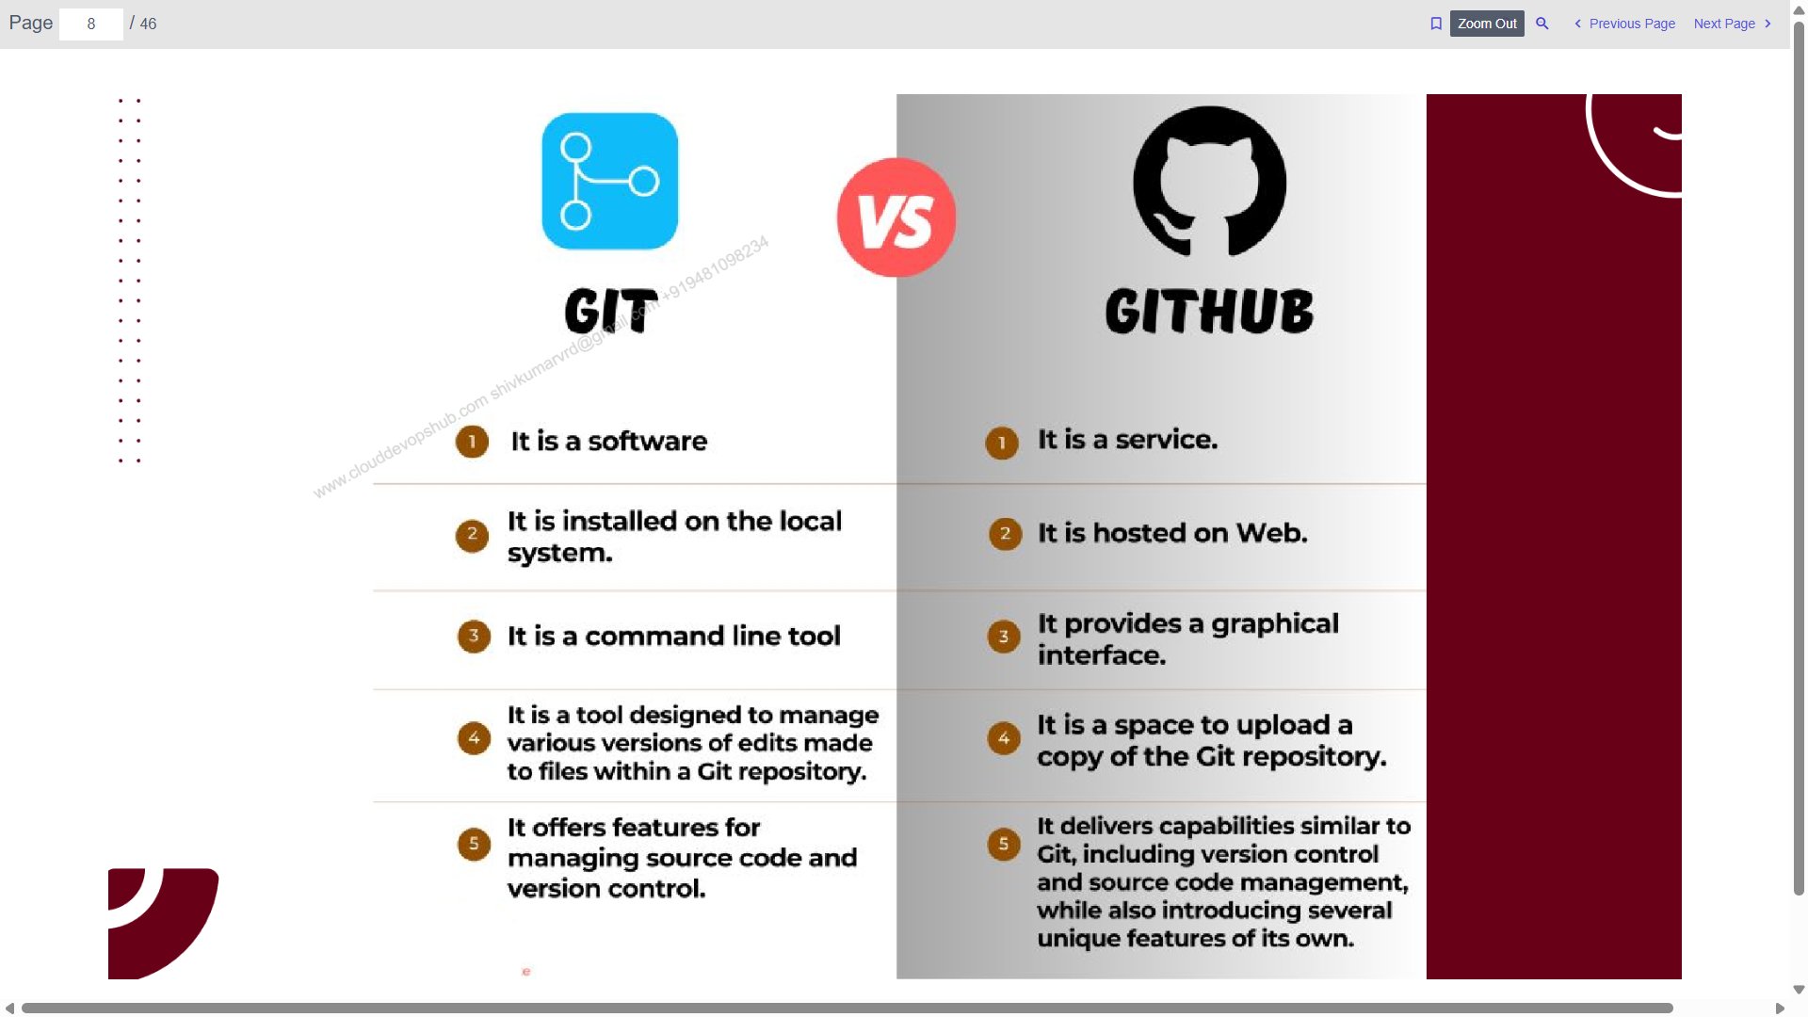

Slide 3
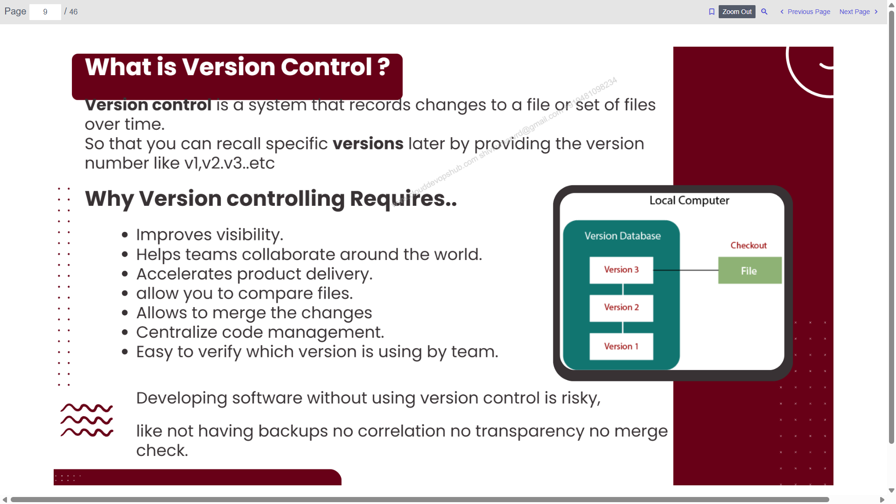

Slide 4
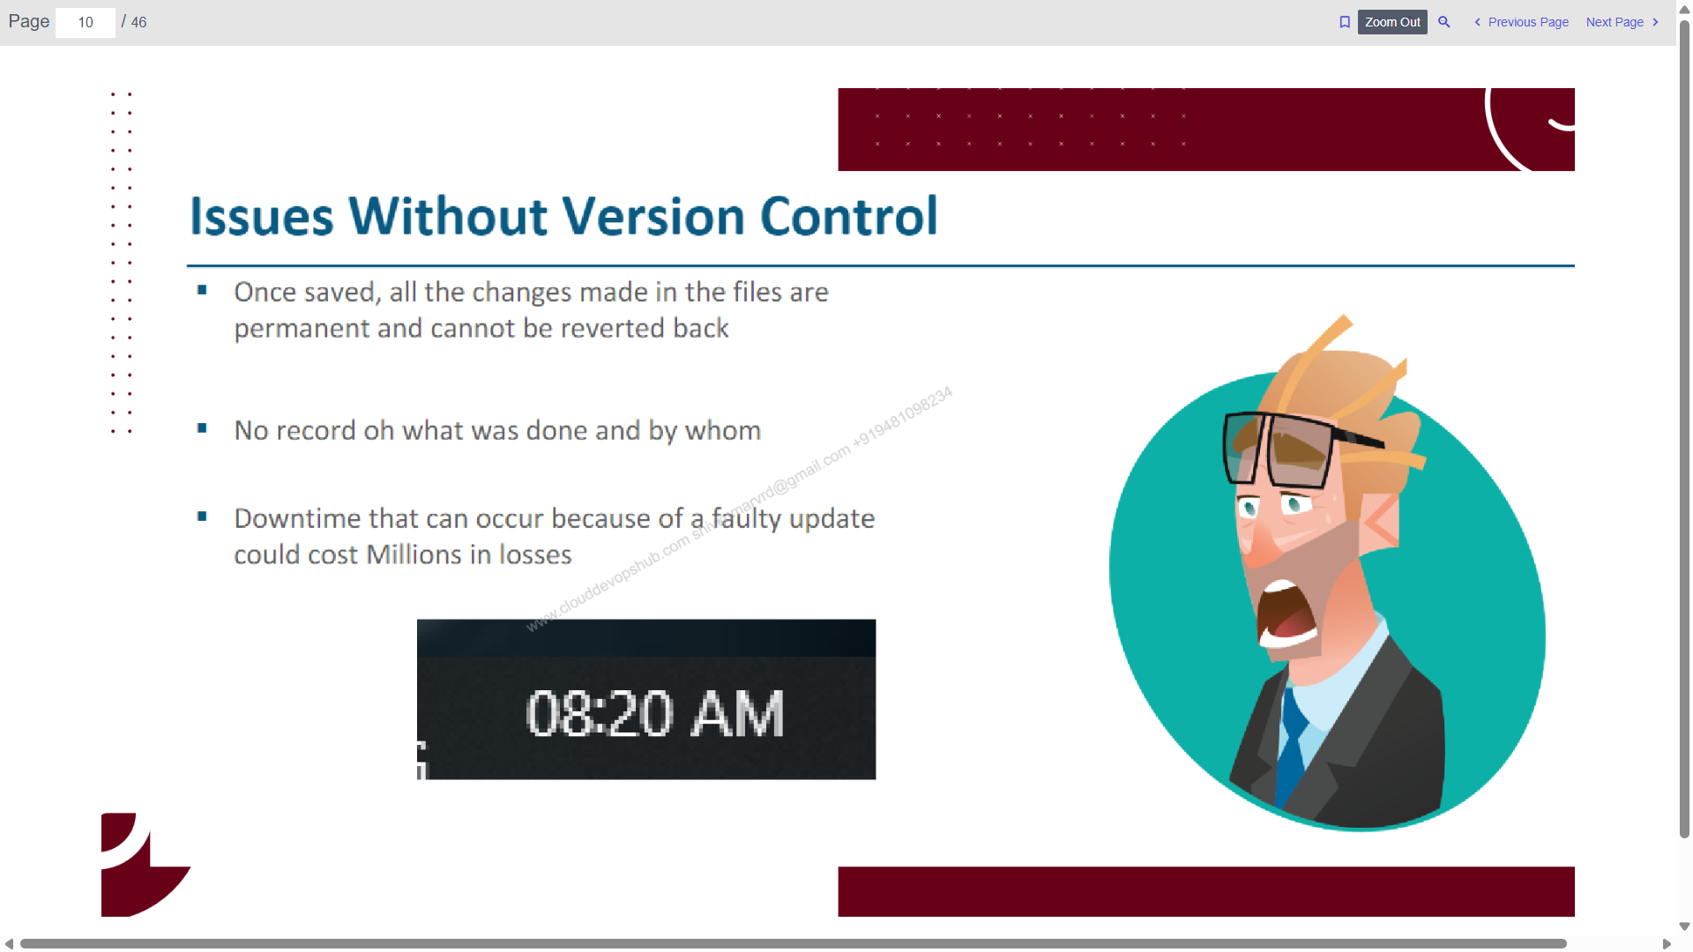

Slide 5
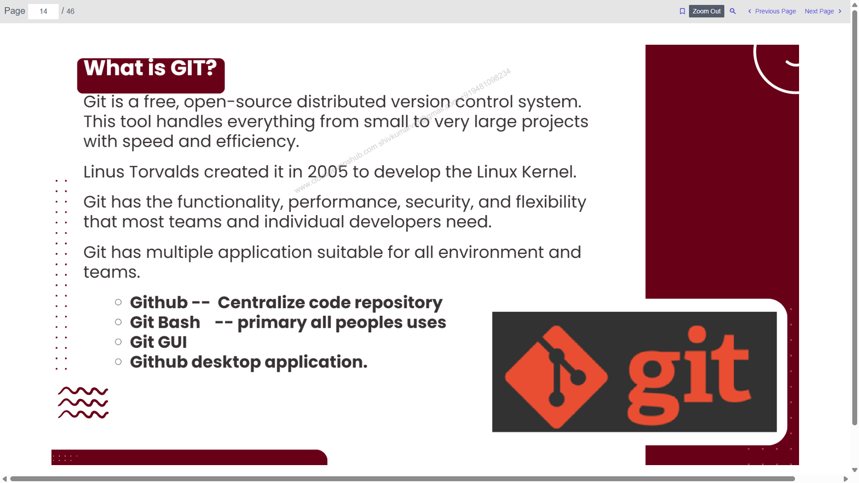

Slide 6
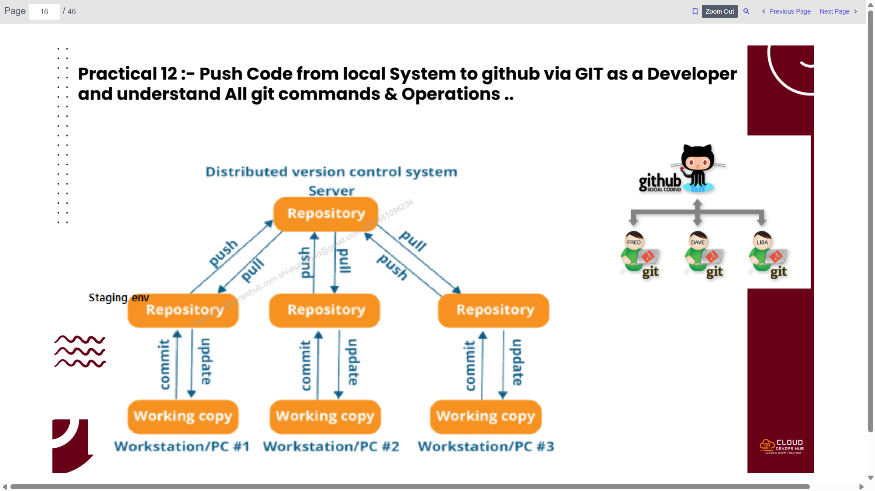

Slide 7
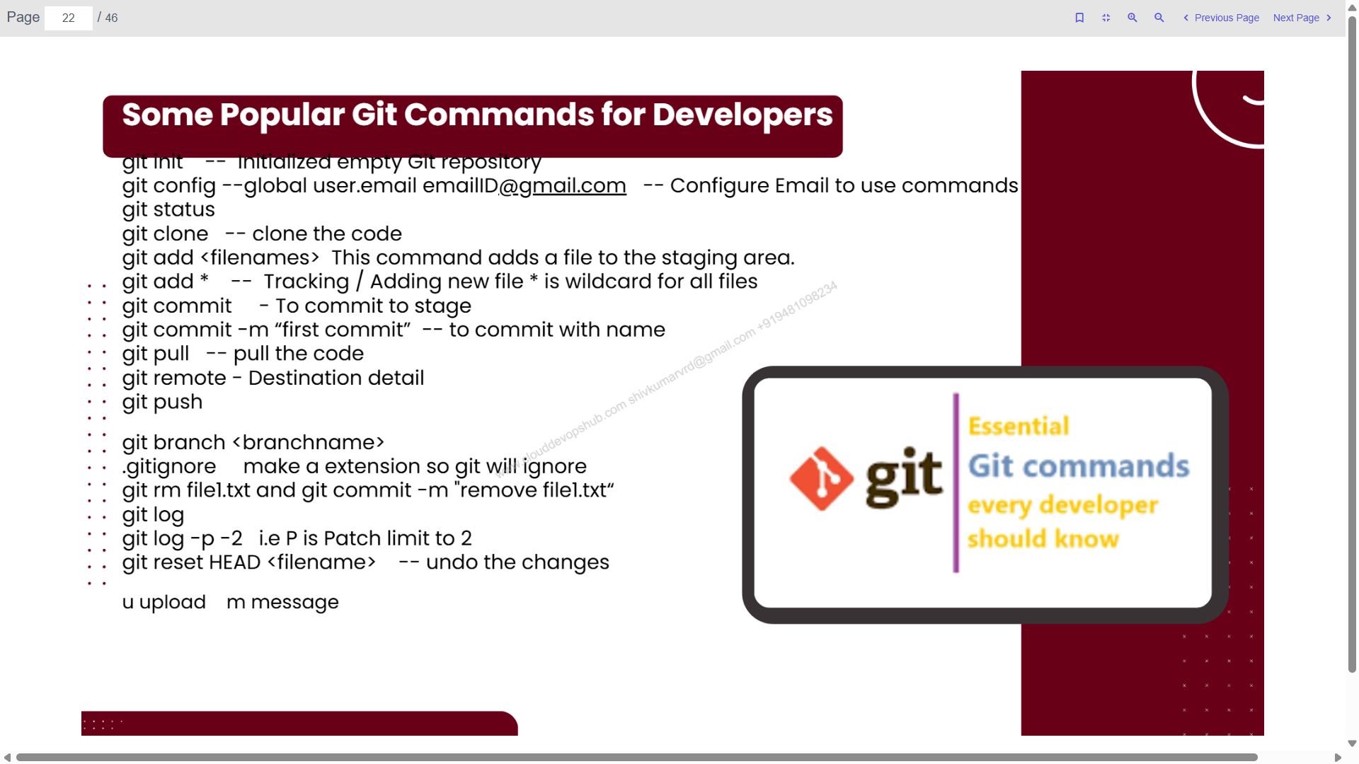

Slide 8
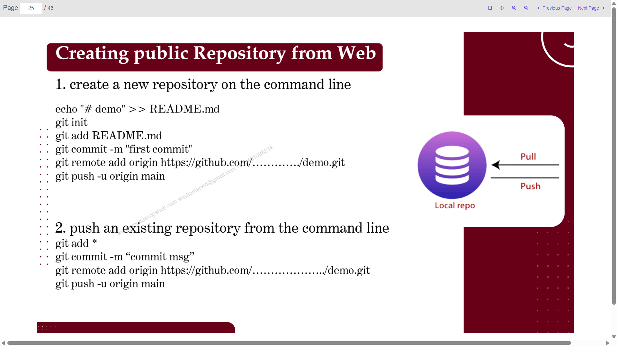

Slide 9
Push code to GIT hub using git bash
Execute code one by one
git config --global user.name "Shiv Kumar"
git config --global user.email shivkumarvrd@gmail.com
echo "# firstrepo" >> README.md
git init
git add README.md
git commit -m "first commit"
git branch -M main
git remote add origin https://github.com/ShivK8431/firstrepo.git
git push -u origin main

Slide 10
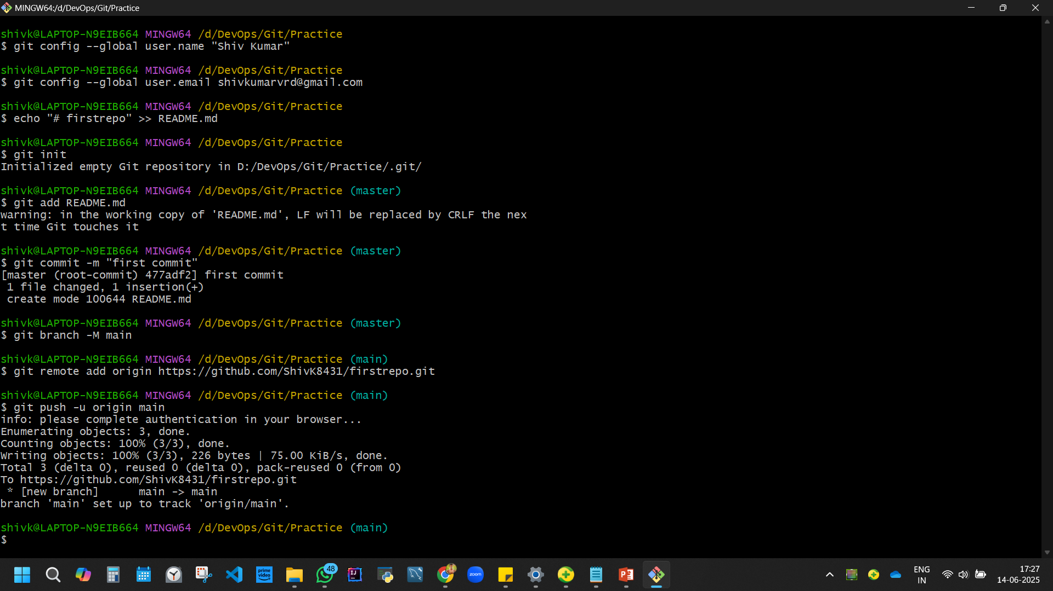
shivk@LAPTOP-N9EIB664 MINGW64 /d/DevOps/Git/Practice
$ git config --global user.name "Shiv Kumar"
shivk@LAPTOP-N9EIB664 MINGW64 /d/DevOps/Git/Practice
$ git config --global user.email shivkumarvrd@gmail.com
shivk@LAPTOP-N9EIB664 MINGW64 /d/DevOps/Git/Practice
$ echo "# firstrepo" >> README.md
shivk@LAPTOP-N9EIB664 MINGW64 /d/DevOps/Git/Practice
$ git init
Initialized empty Git repository in D:/DevOps/Git/Practice/.git/
shivk@LAPTOP-N9EIB664 MINGW64 /d/DevOps/Git/Practice (master)
$ git add README.md
warning: in the working copy of 'README.md', LF will be replaced by CRLF the next time Git touches it
shivk@LAPTOP-N9EIB664 MINGW64 /d/DevOps/Git/Practice (master)
$ git commit -m "first commit"
[master (root-commit) 477adf2] first commit
1 file changed, 1 insertion(+)
create mode 100644 README.md
shivk@LAPTOP-N9EIB664 MINGW64 /d/DevOps/Git/Practice (master)
$ git branch -M main
shivk@LAPTOP-N9EIB664 MINGW64 /d/DevOps/Git/Practice (main)
$ git remote add origin https://github.com/ShivK8431/firstrepo.git
shivk@LAPTOP-N9EIB664 MINGW64 /d/DevOps/Git/Practice (main)
$ git push -u origin main
info: please complete authentication in your browser...
Enumerating objects: 3, done.
Counting objects: 100% (3/3), done.
Writing objects: 100% (3/3), 226 bytes | 75.00 KiB/s, done.
Total 3 (delta 0), reused 0 (delta 0), pack-reused 0 (from 0)
To https://github.com/ShivK8431/firstrepo.git
* [new branch] main -> main
branch 'main' set up to track 'origin/main'.
shivk@LAPTOP-N9EIB664 MINGW64 /d/DevOps/Git/Practice (main)

Slide 11
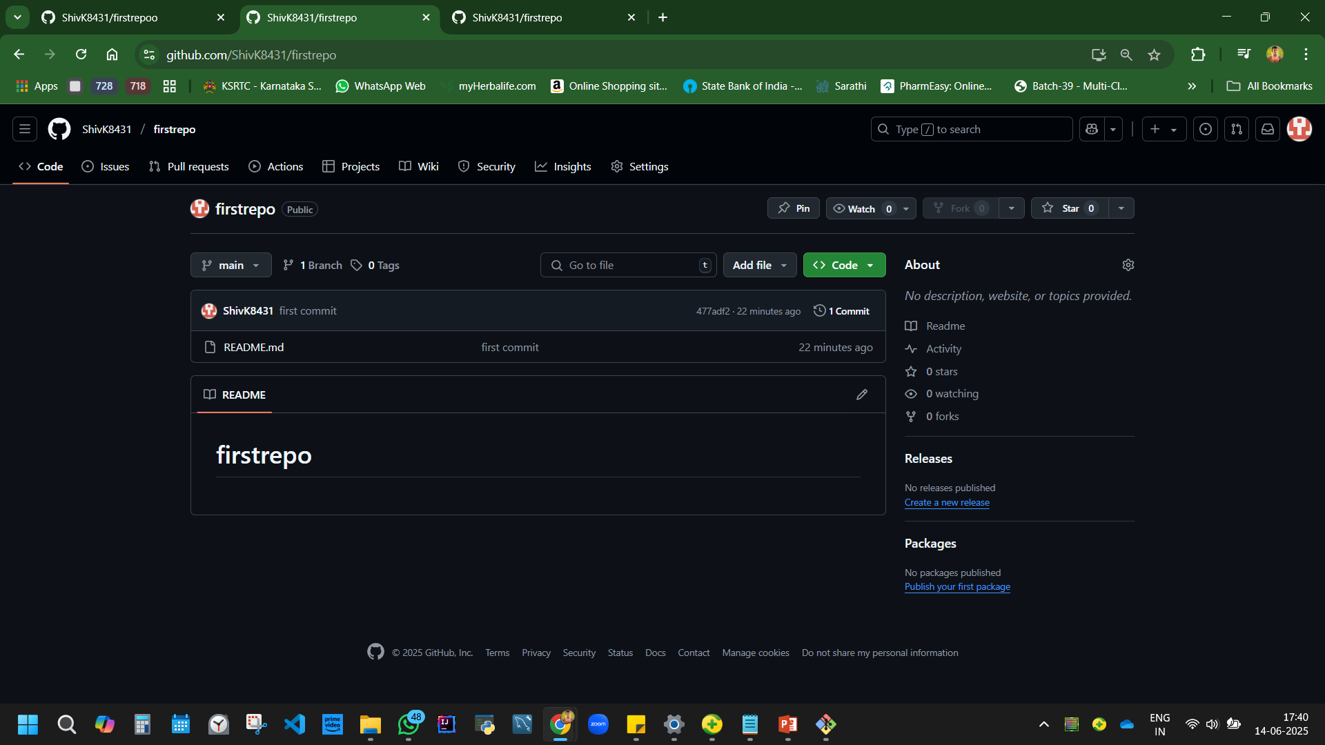

Slide 12
Added a new file in workspace (folder)
git add *
git status
git commit -m "Add new file"
git push

Slide 13
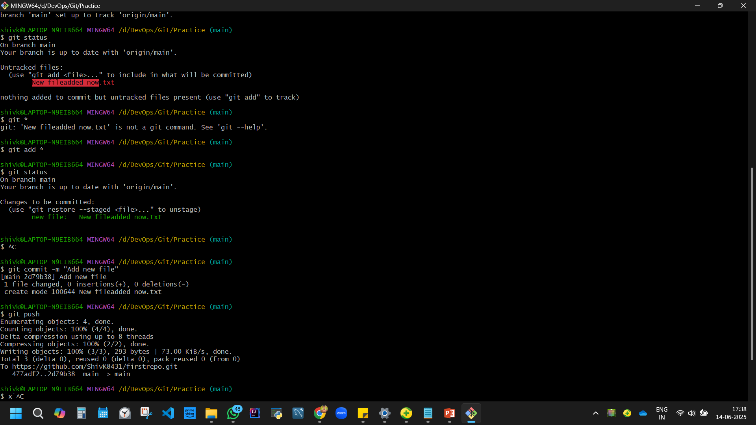

Slide 14
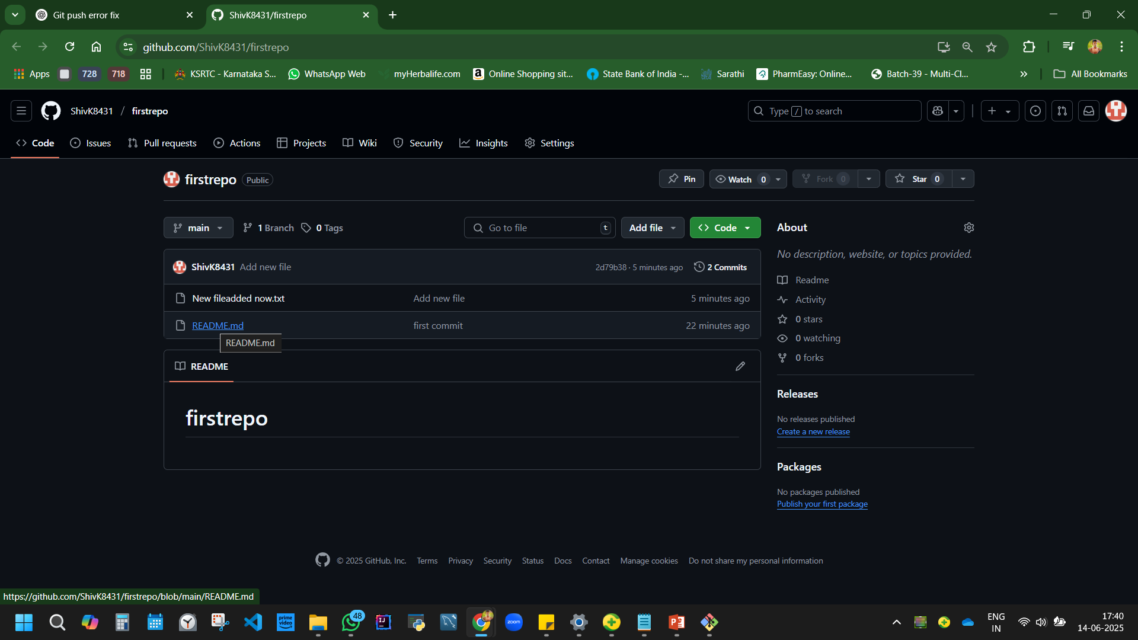
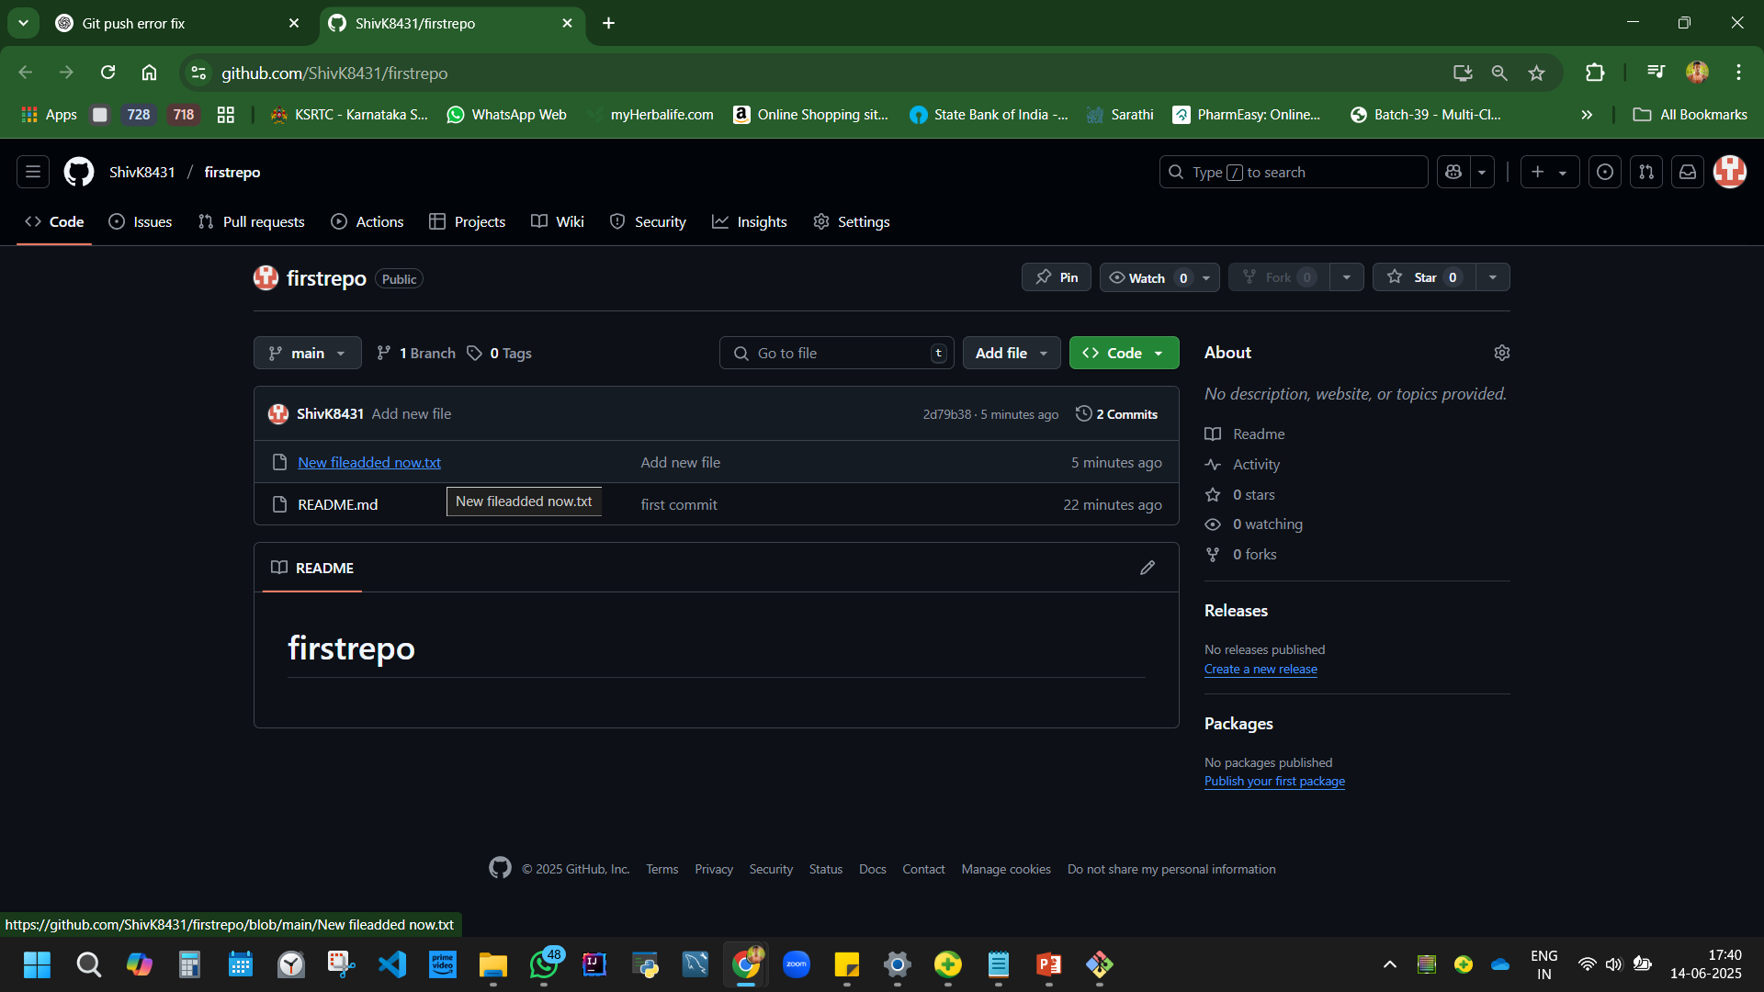

Slide 15
Push code to GIT hub using Visual studio code Execute code one by one
Create a folder. Right click – open with vs code.
Terminal - Add code
echo "# day2-of-git" >> README.md
git init
git status or
Git add * or git add README.md
git commit -m "first commit for day 2"
git branch -M main
git remote add origin https://github.com/ShivK8431/day2-of-git.git
git push -u origin main

Slide 16
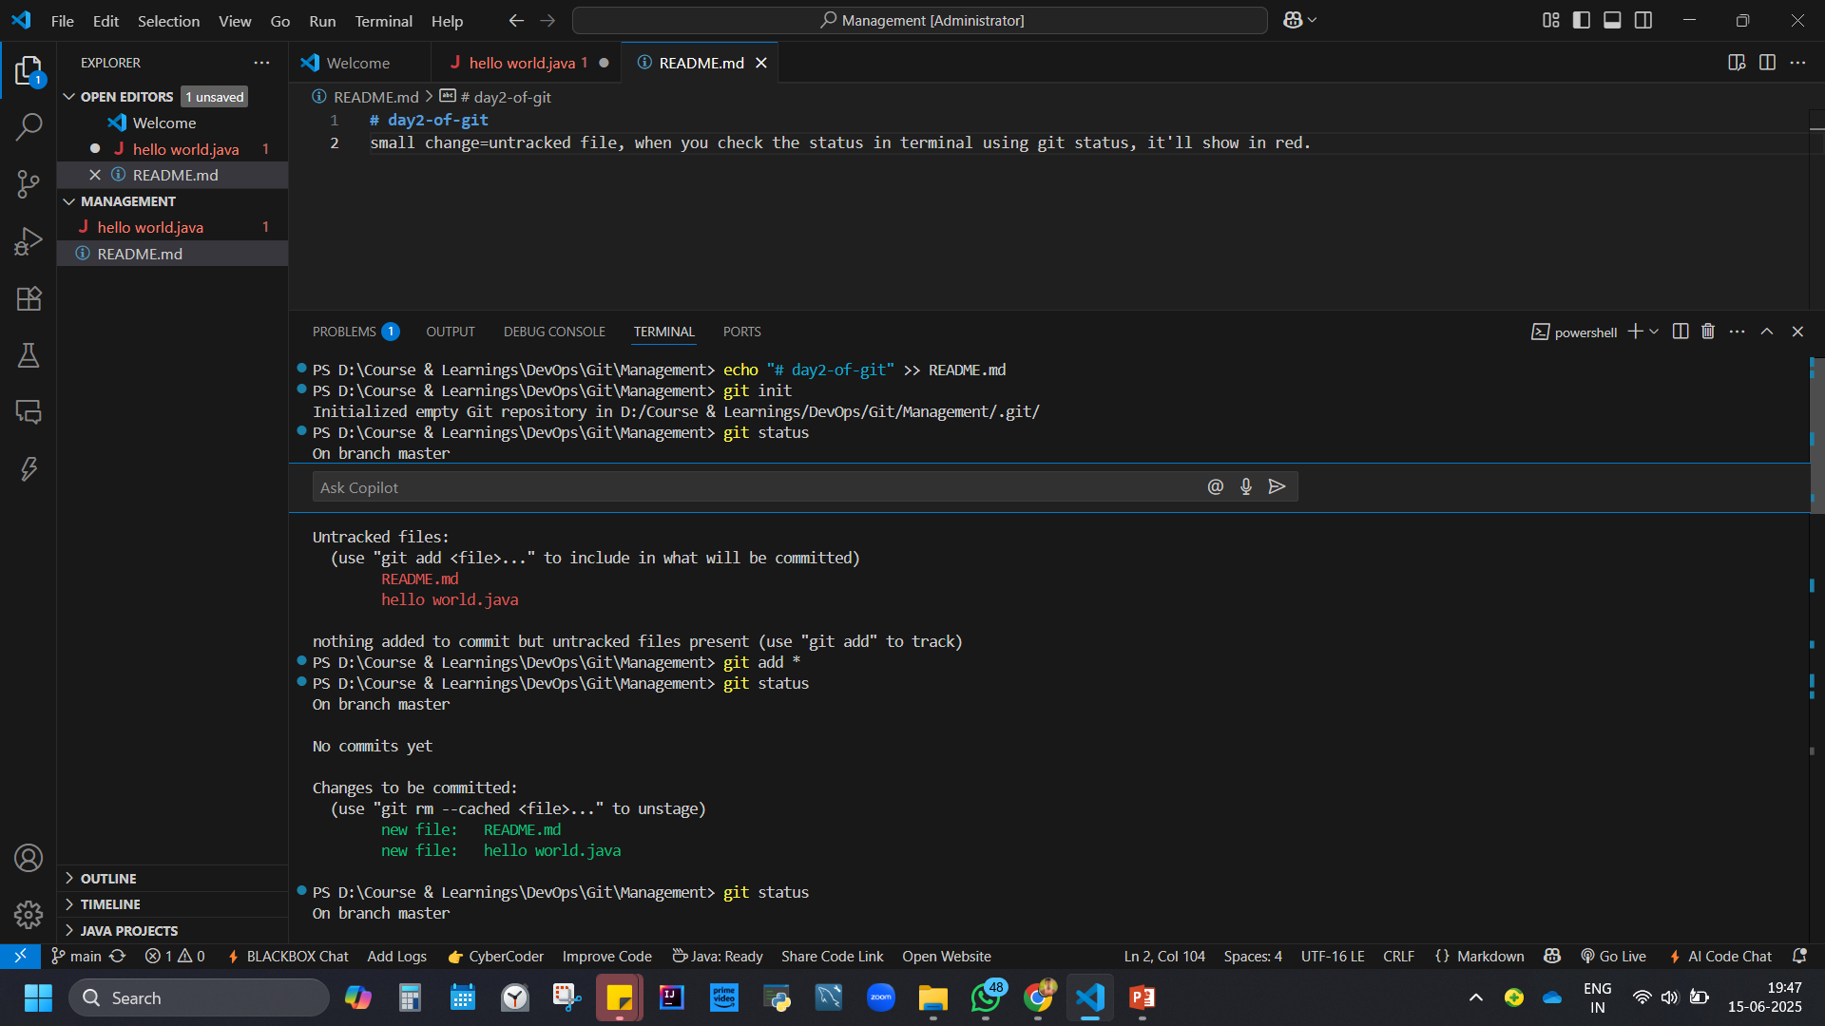

Slide 17
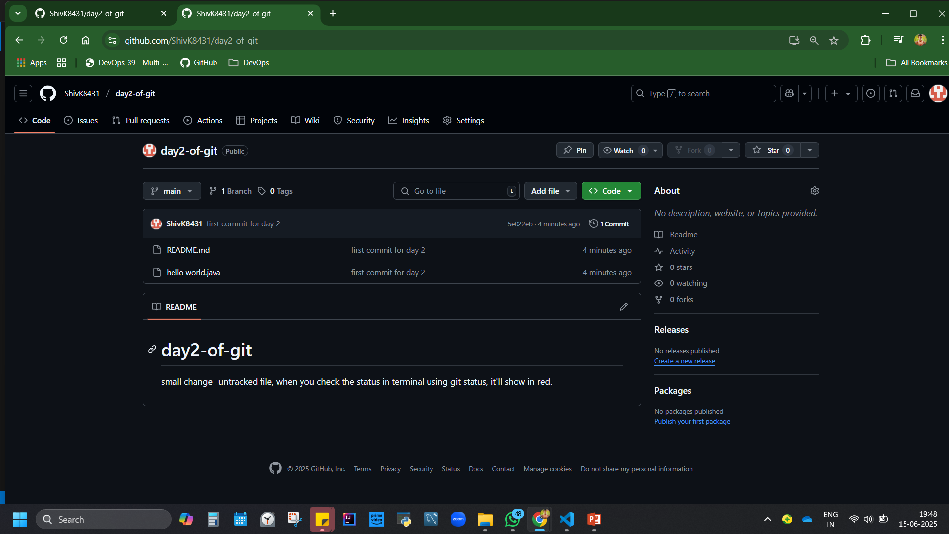

Slide 18
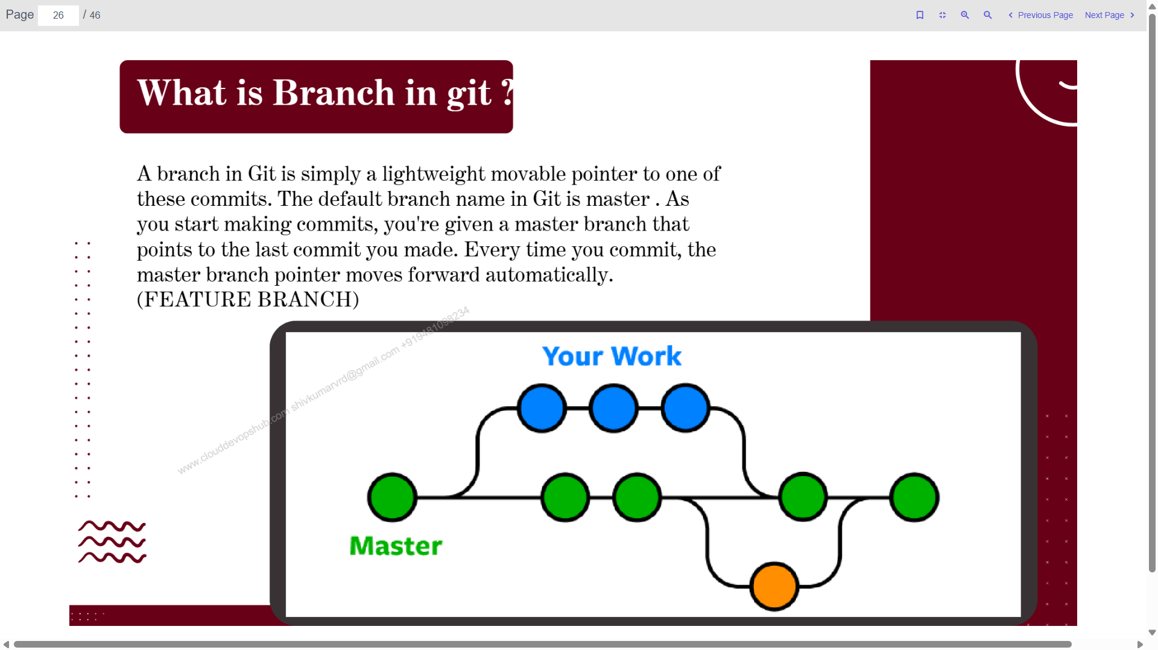

Slide 19
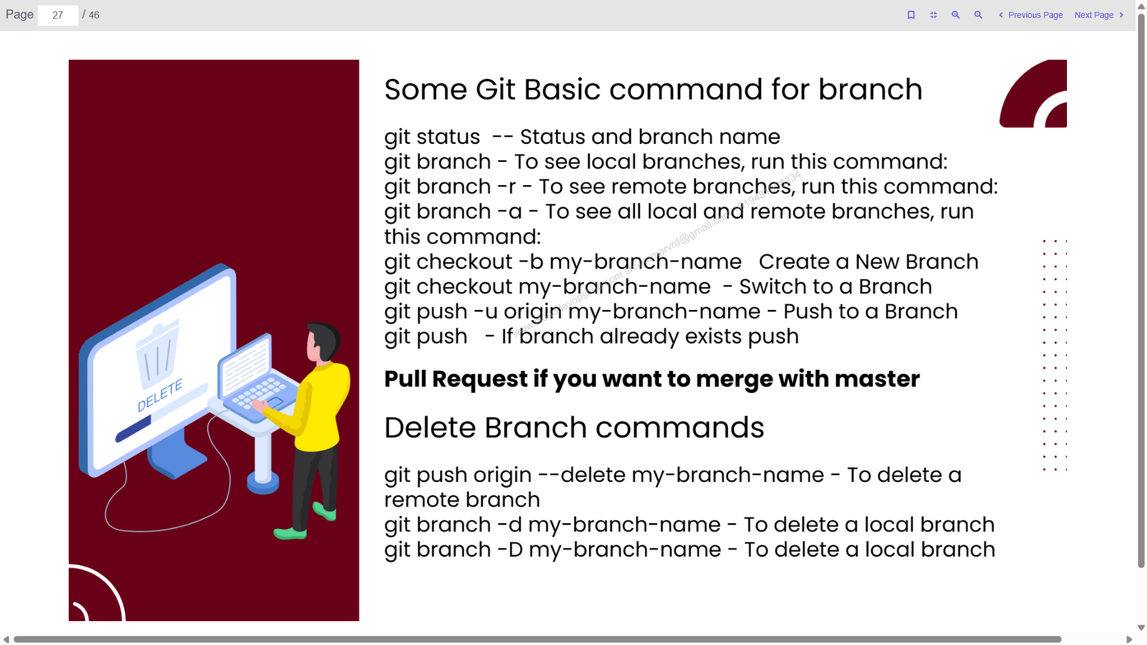

Slide 20
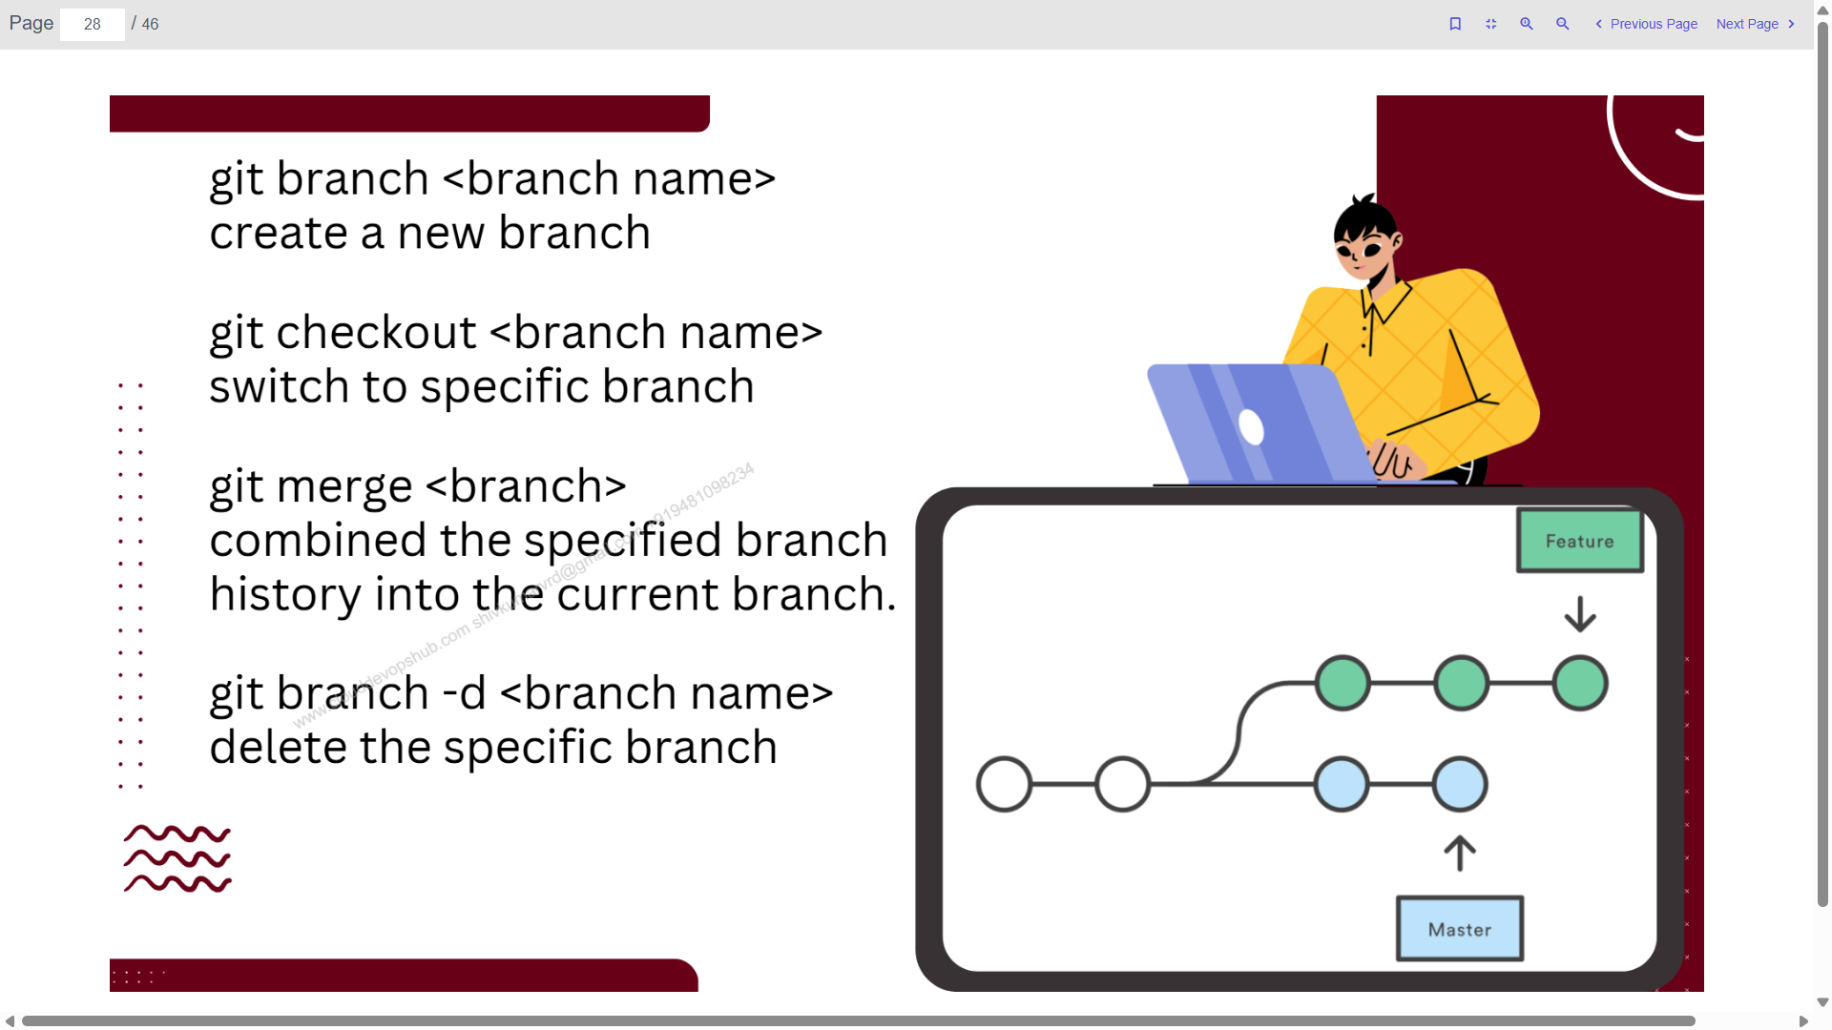

Slide 21
CI CD

Slide 22
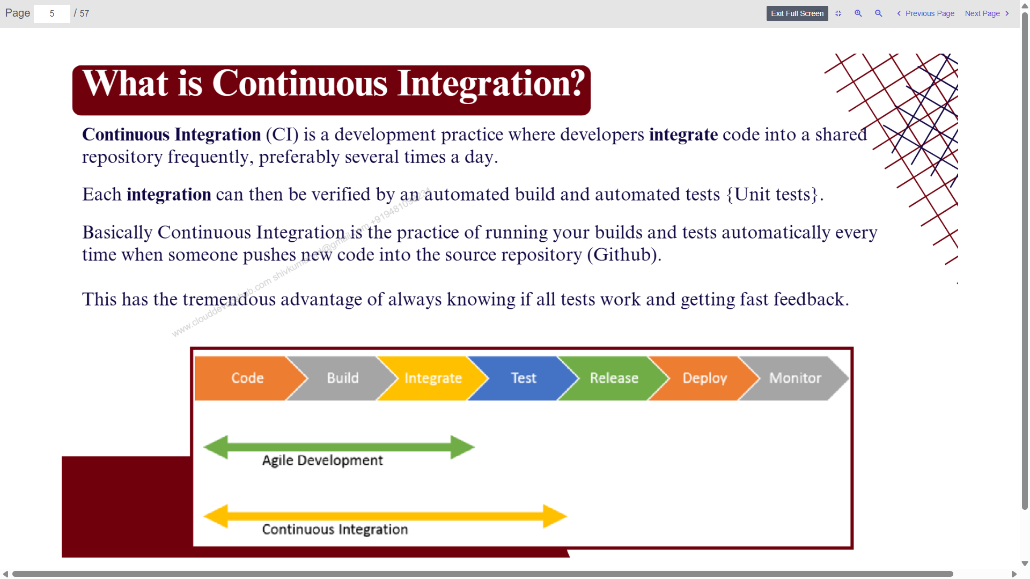

Slide 23
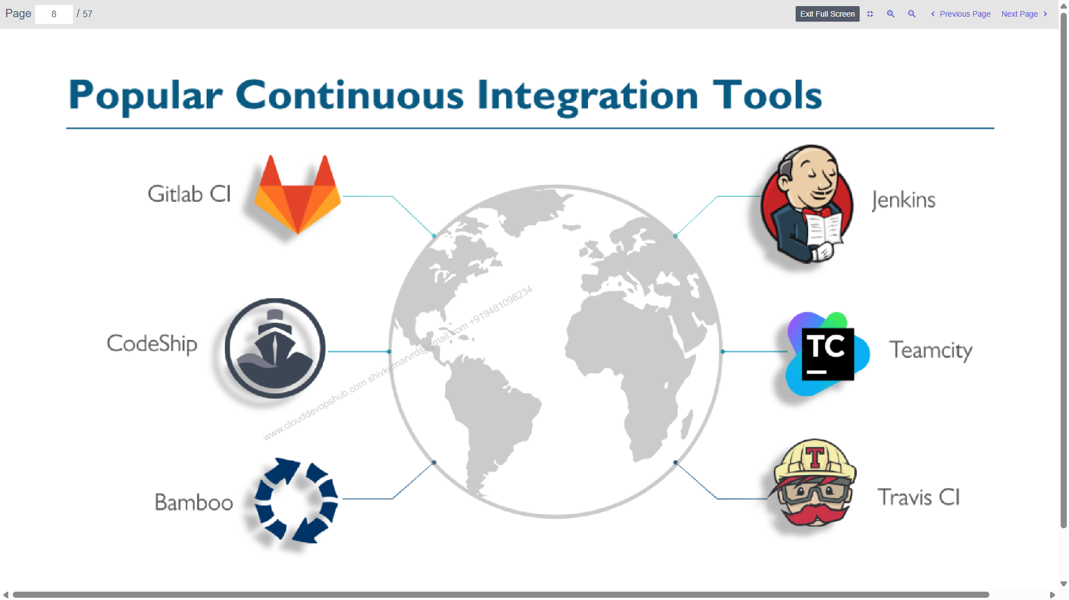

Slide 24
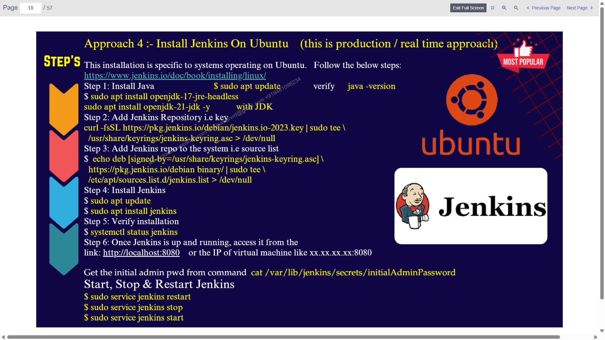

Slide 25
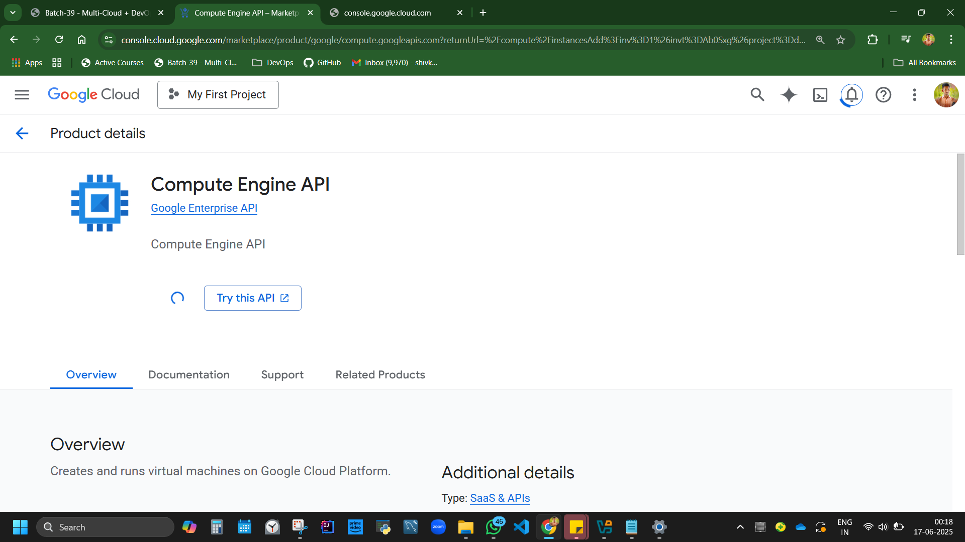

Slide 26
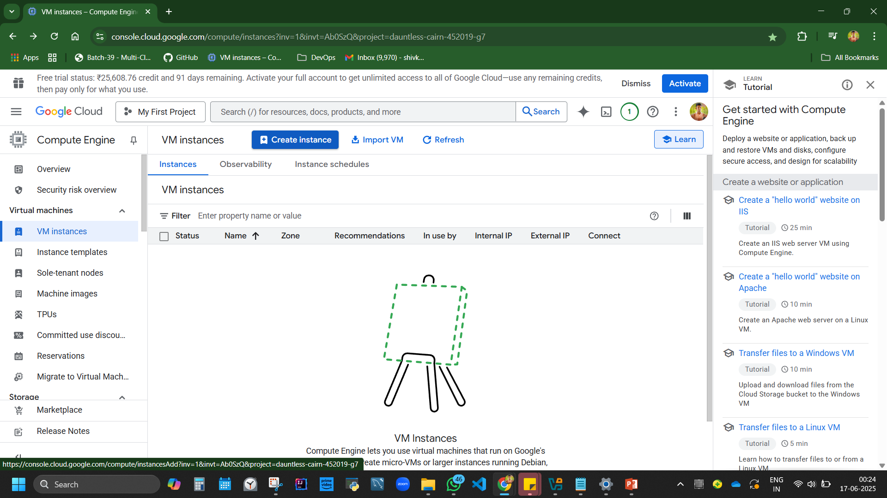
https://console.cloud.google.com/compute/instancesAdd?inv=1&invt=Ab0SzQ&project=dauntless-cairn-452019-g7
Create Ubuntu machine

Slide 27
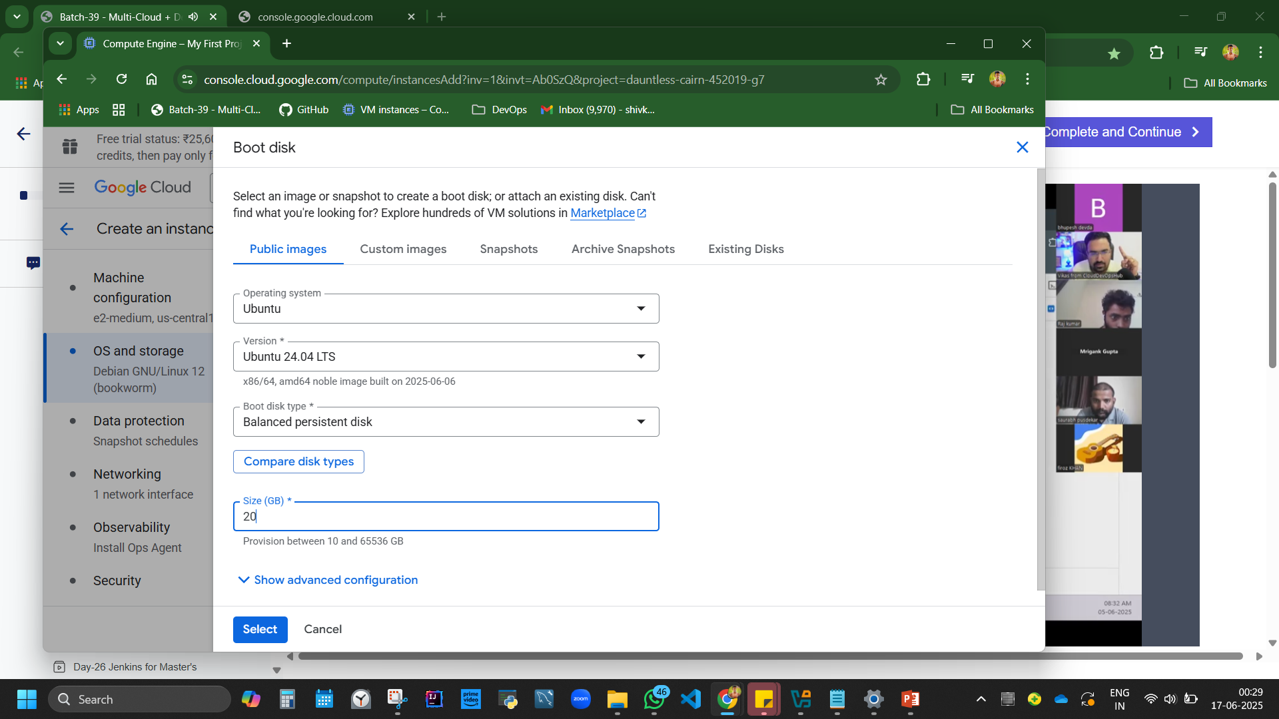

Slide 28
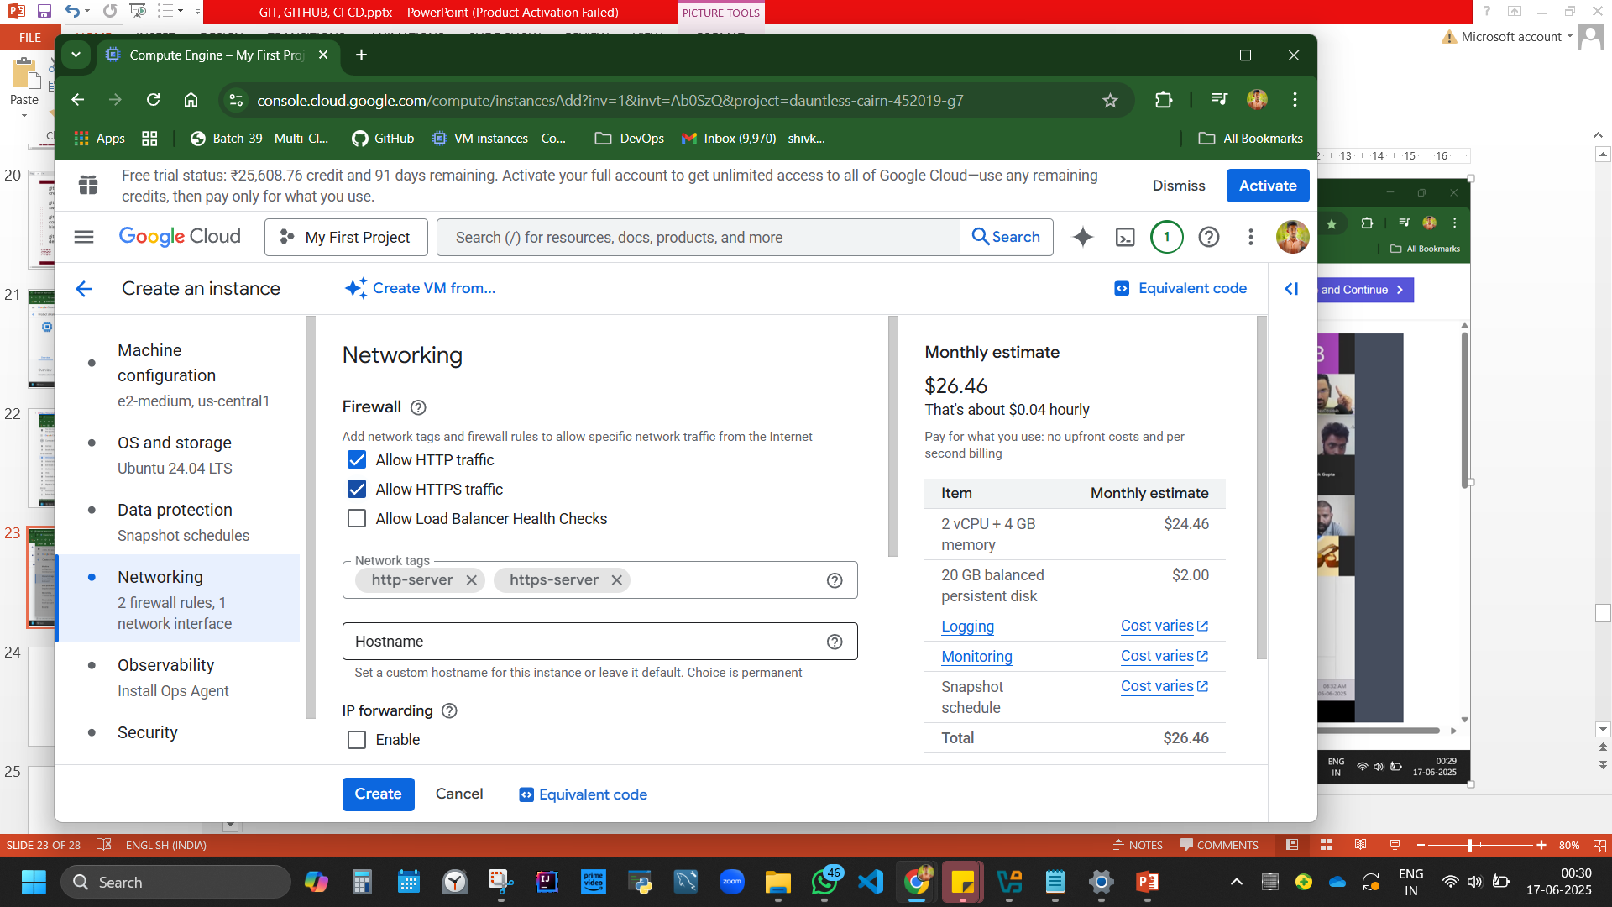

Slide 29
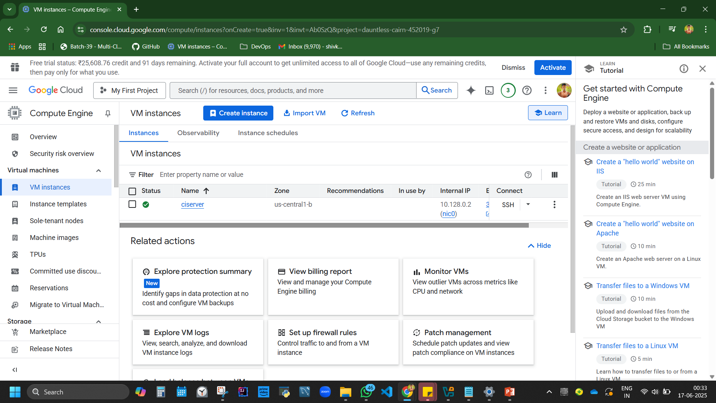

Slide 30
$ sudo apt install openjdk-17-jre-headless
# Add the key
curl -fsSL https://pkg.jenkins.io/debian/jenkins.io-2023.key | sudo tee /usr/share/keyrings/jenkins-keyring.asc > /dev/null
# Add Jenkins repository
echo deb [signed-by=/usr/share/keyrings/jenkins-keyring.asc] https://pkg.jenkins.io/debian binary/ | sudo tee /etc/apt/sources.list.d/jenkins.list > /dev/null

Slide 31
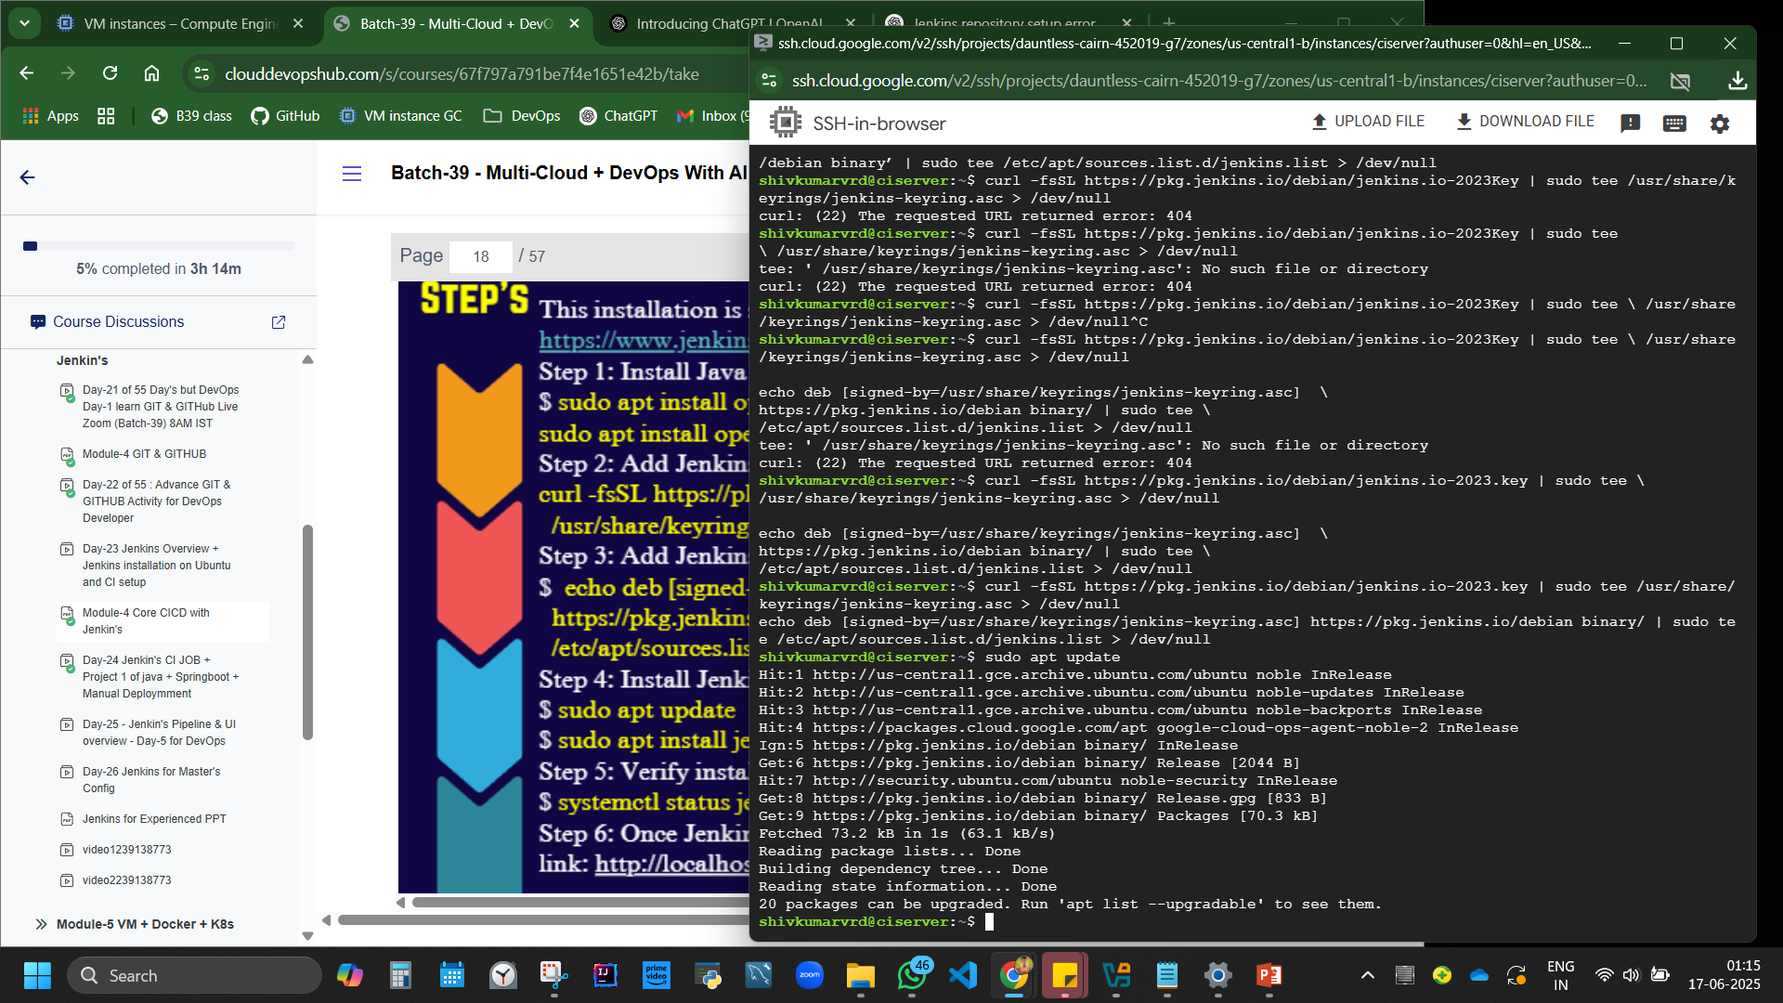

Slide 32
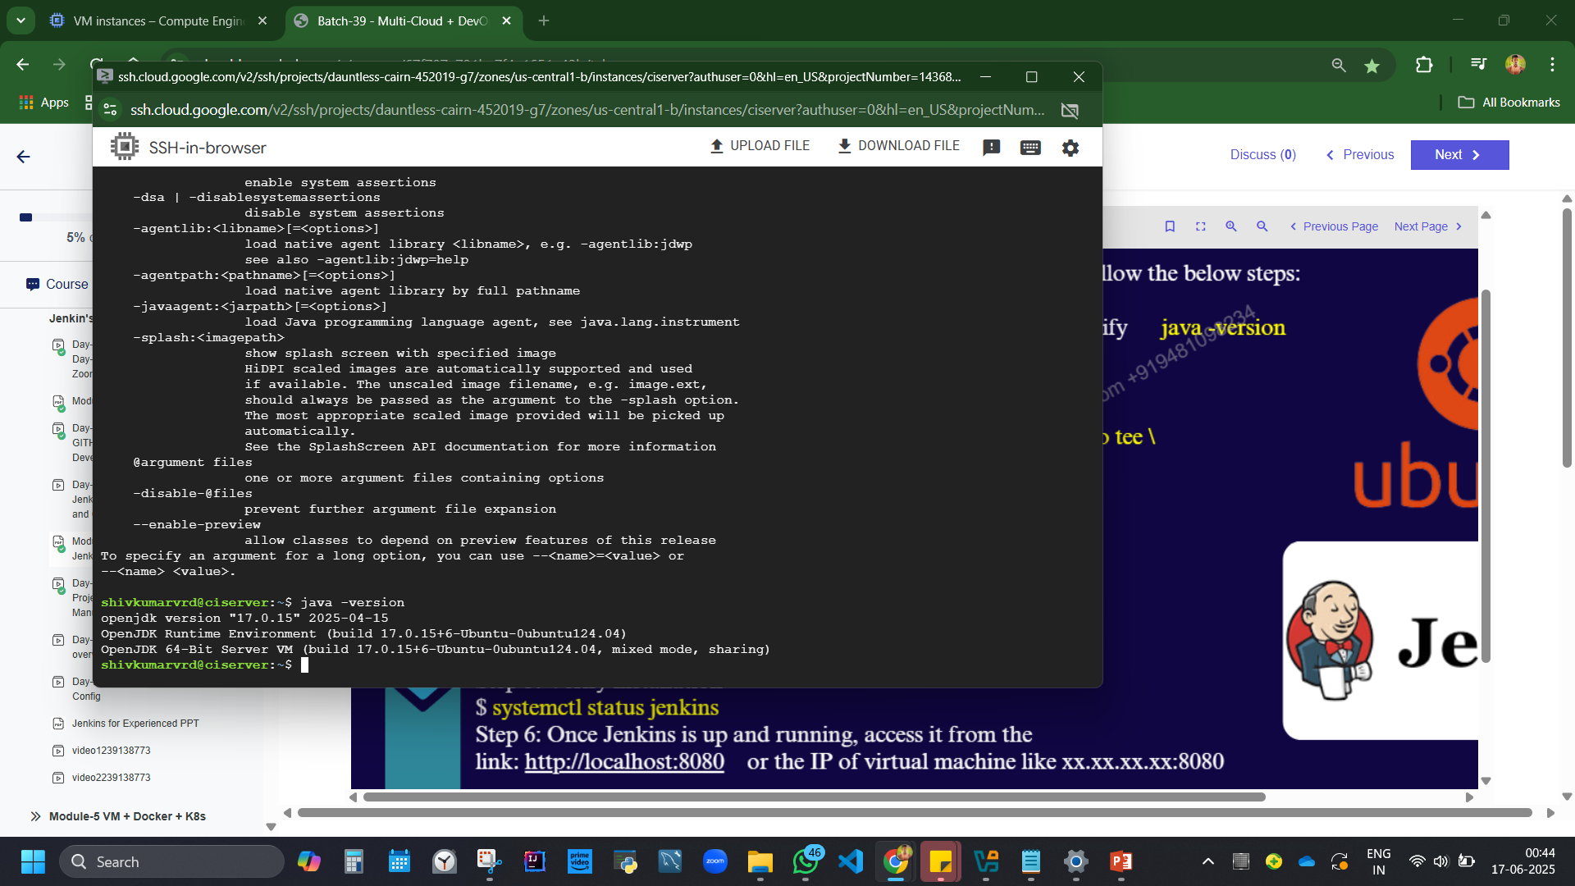

Slide 33
sudo apt install openjdk-17-jre-headless
# Add the key
curl -fsSL https://pkg.jenkins.io/debian/jenkins.io-2023.key | sudo tee /usr/share/keyrings/jenkins-keyring.asc > /dev/null
# Add Jenkins repository
echo deb [signed-by=/usr/share/keyrings/jenkins-keyring.asc] https://pkg.jenkins.io/debian binary/ | sudo tee /etc/apt/sources.list.d/jenkins.list > /dev/null
sudo apt update
sudo apt install Jenkins
systemctl status jenkins

Slide 34
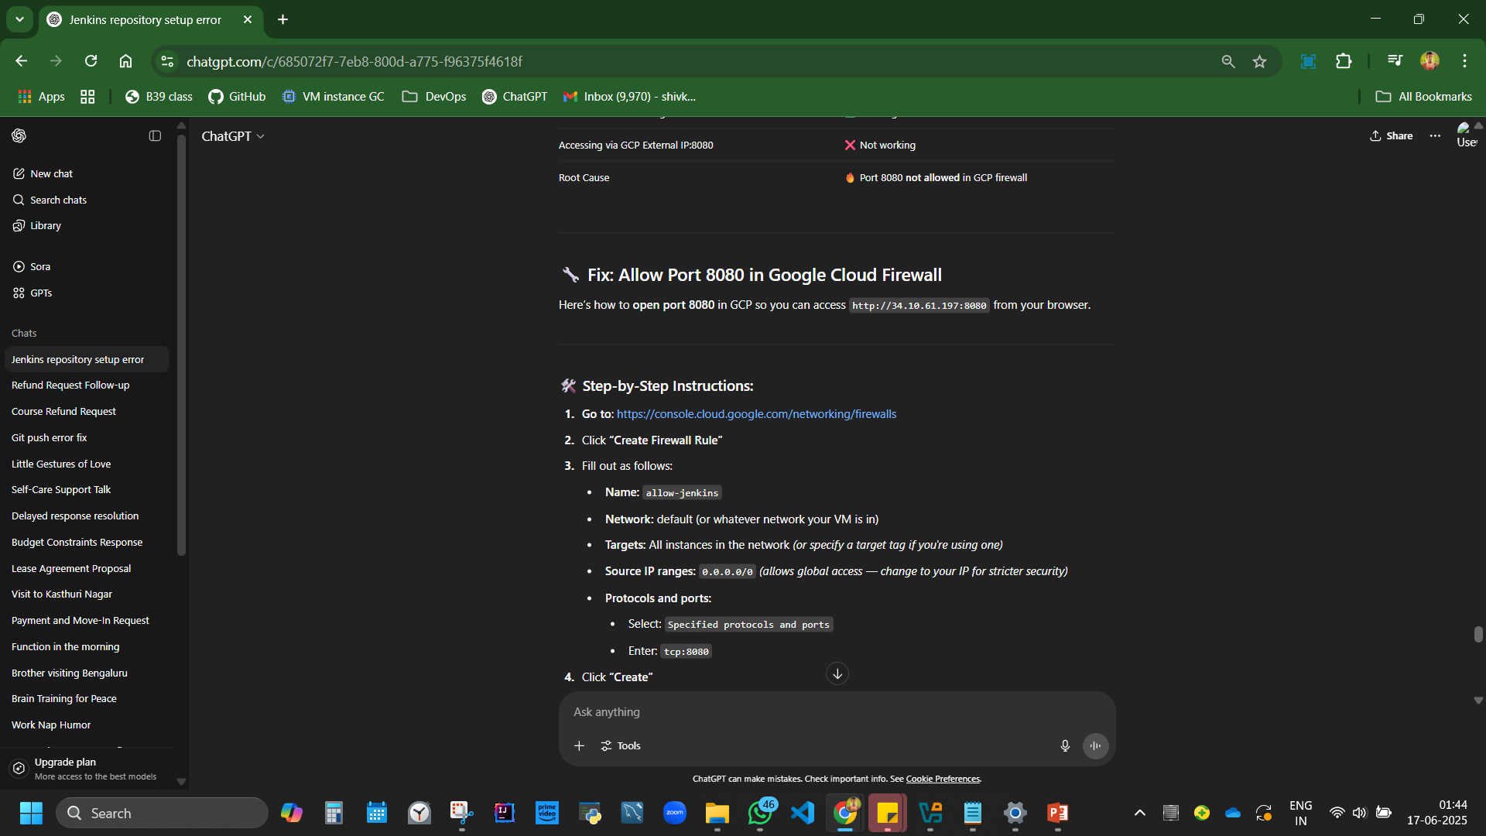

Slide 35
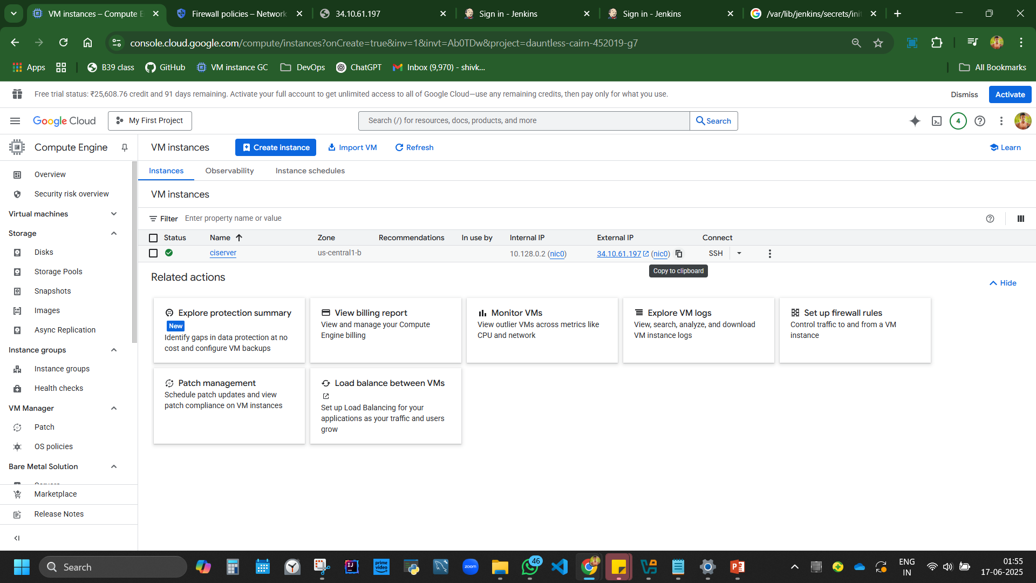

Slide 36
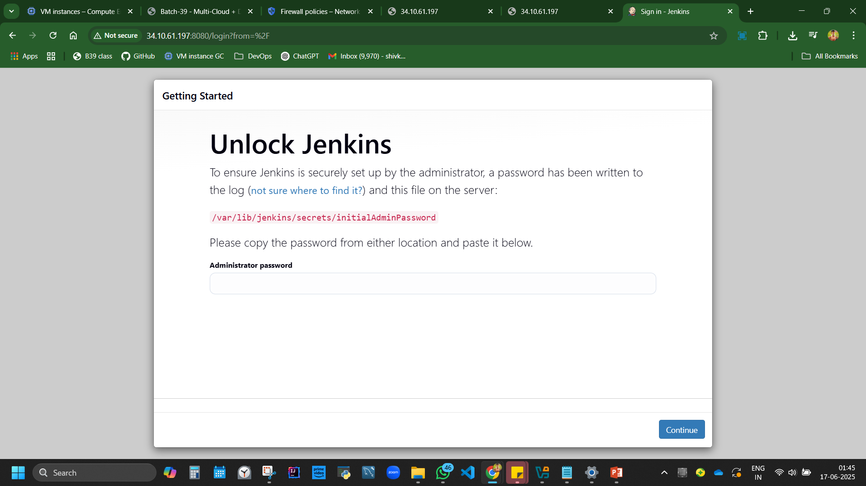

Slide 37
sudo cat /var/lib/jenkins/secrets/initialAdminPassword

Slide 38
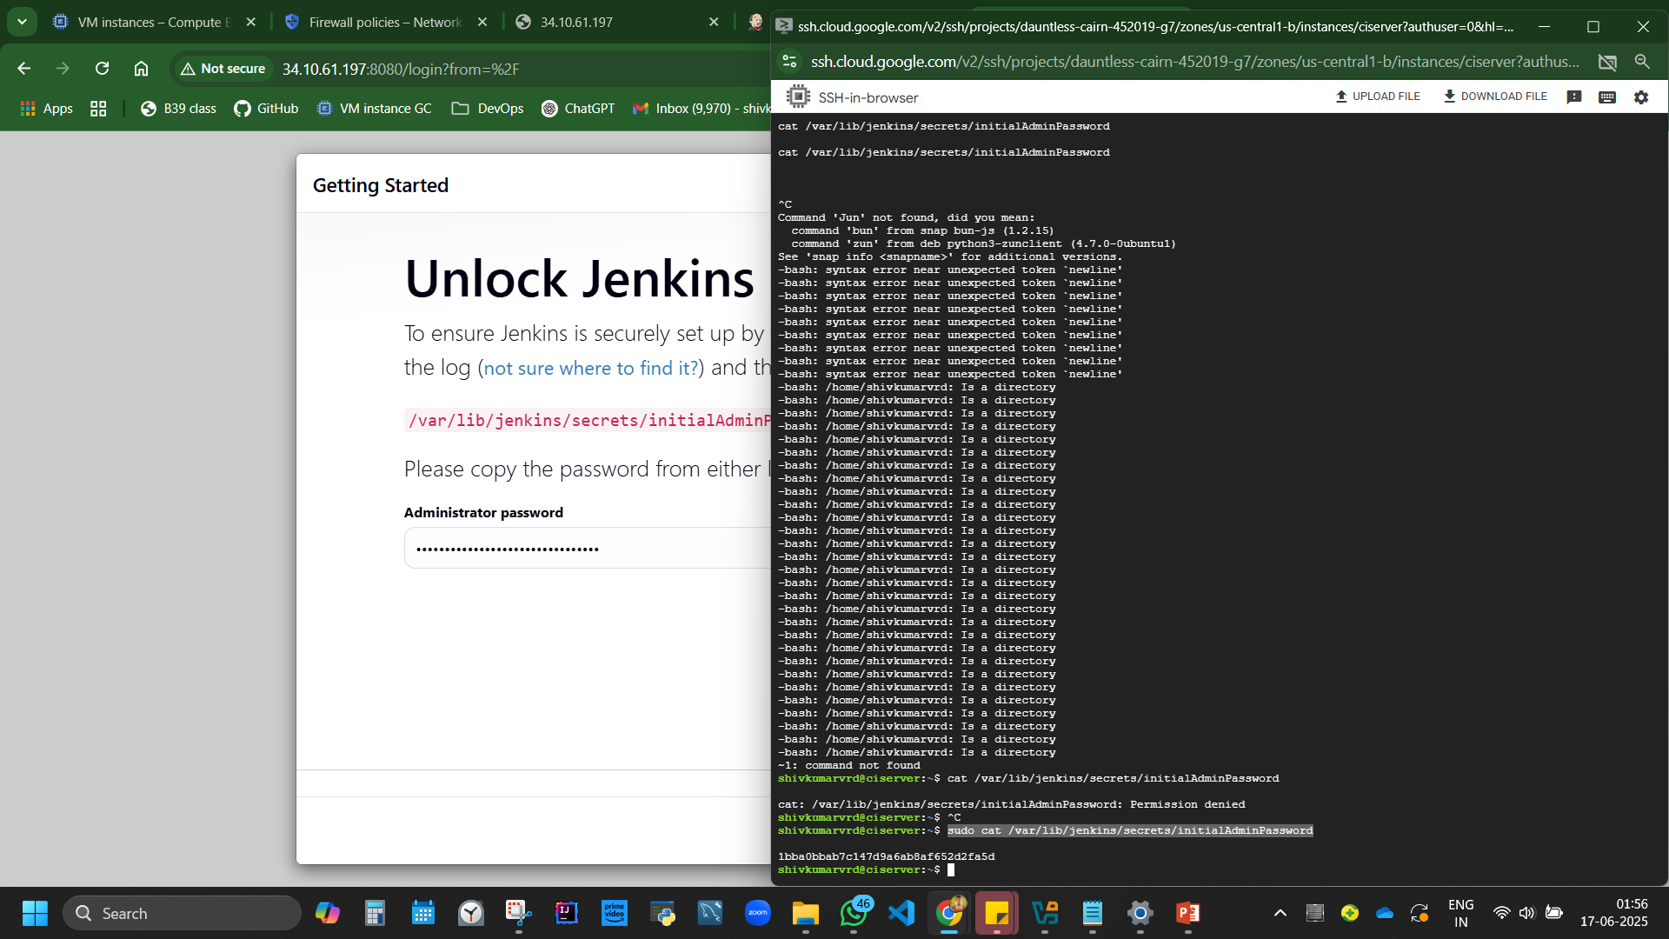

Slide 39
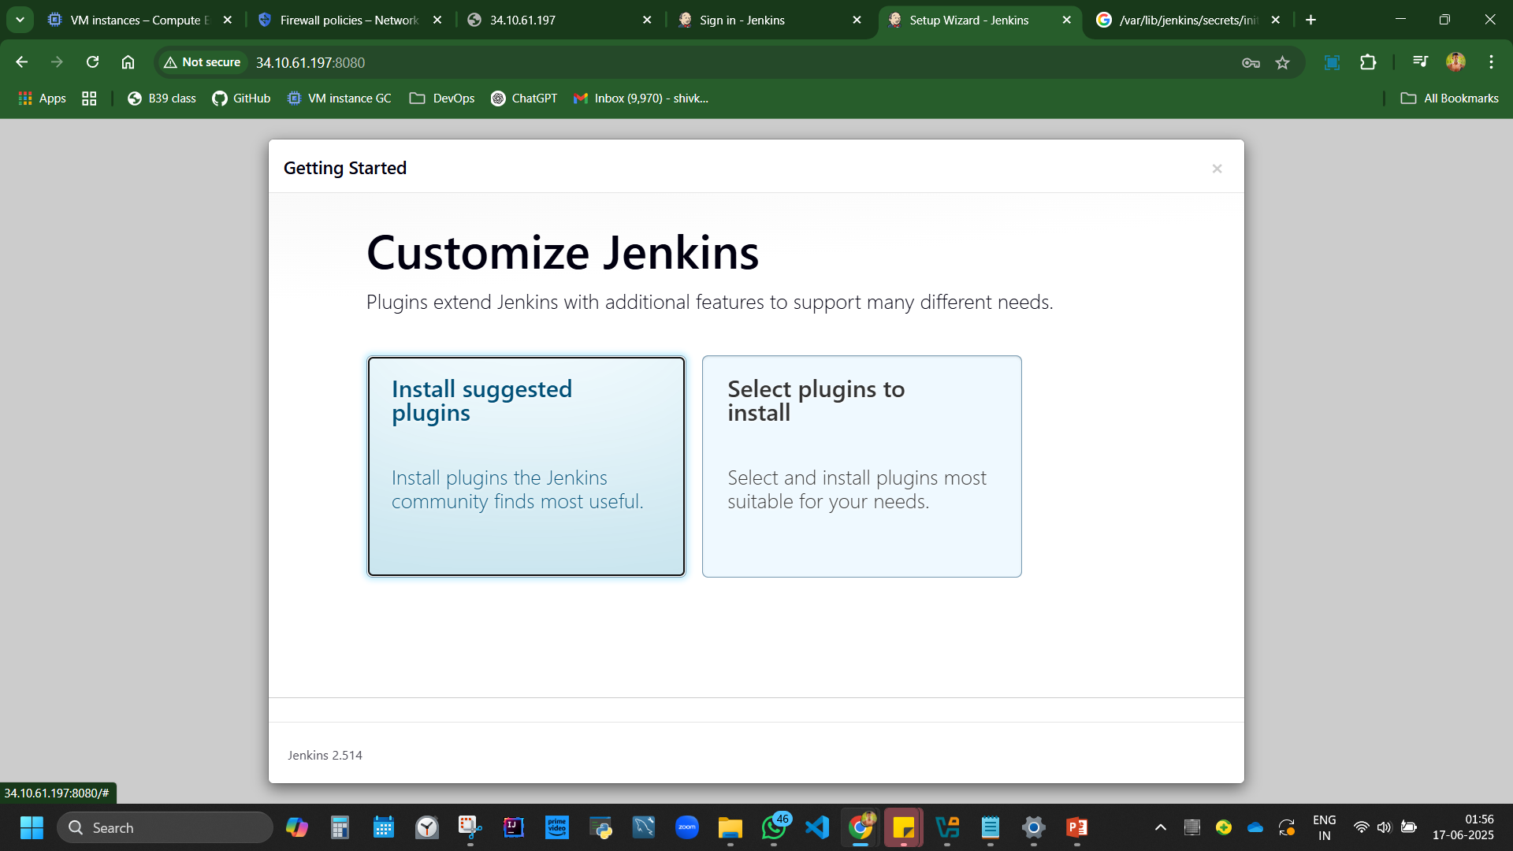
Install pluginnnnnns

Slide 40
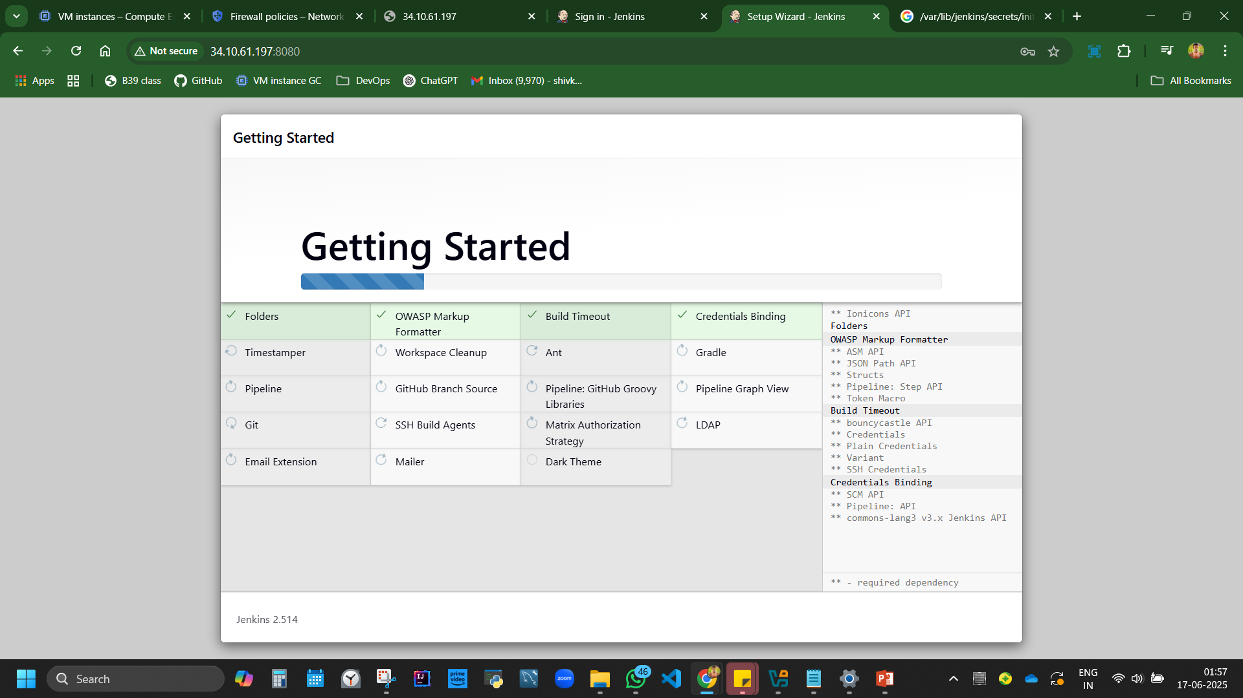

Slide 41
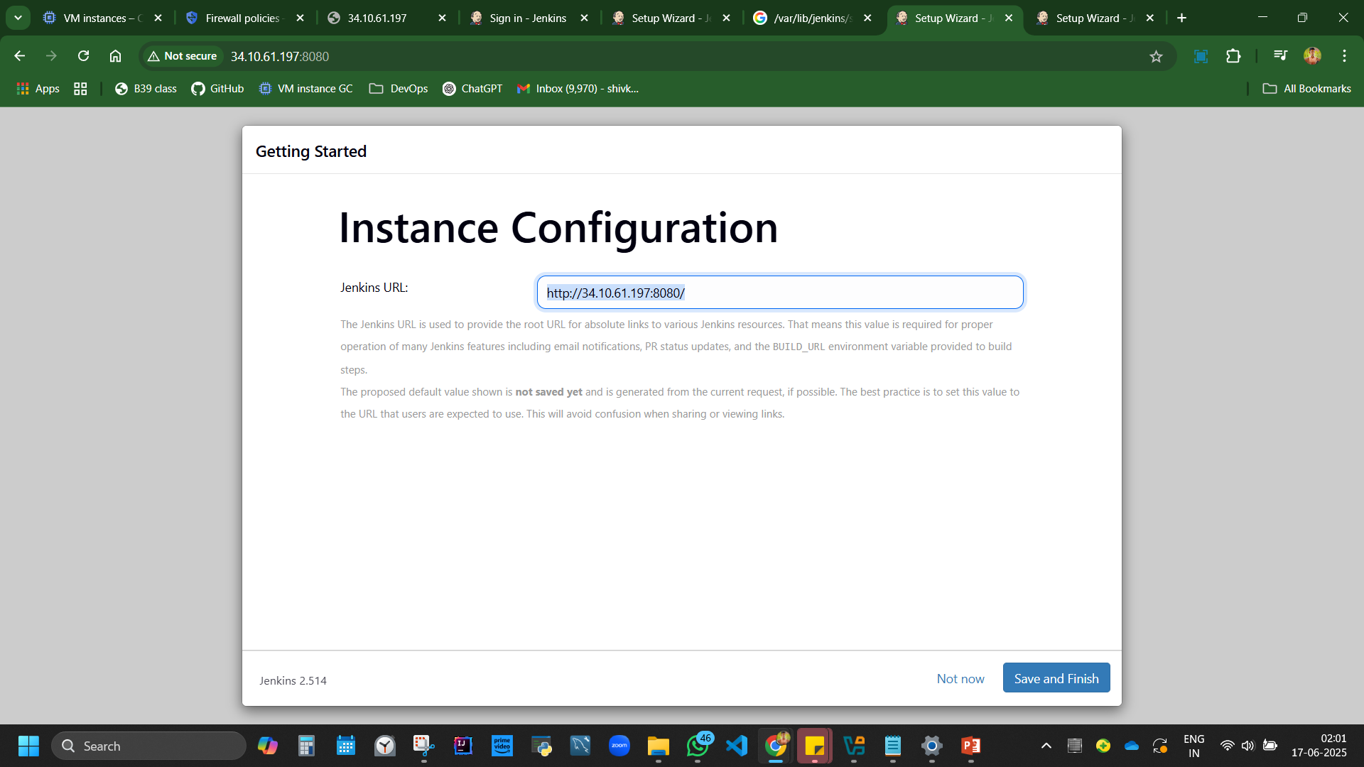
Admin admin admin

Slide 42
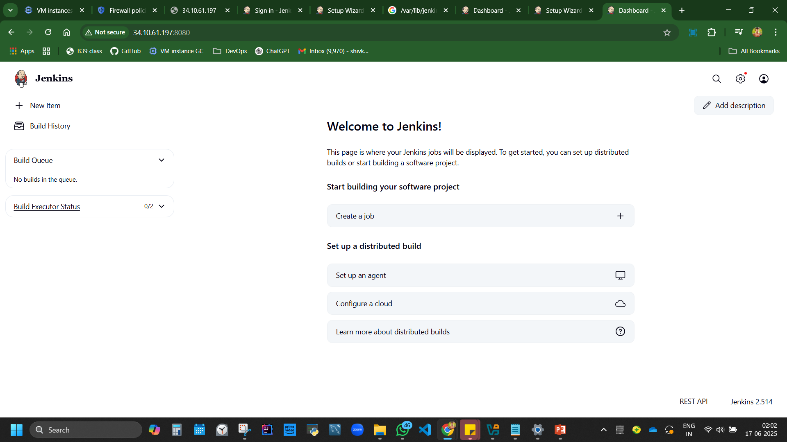

Slide 43
Install Jenkins from Linux
https://www.jenkins.io/doc/book/installing/linux/

Slide 44
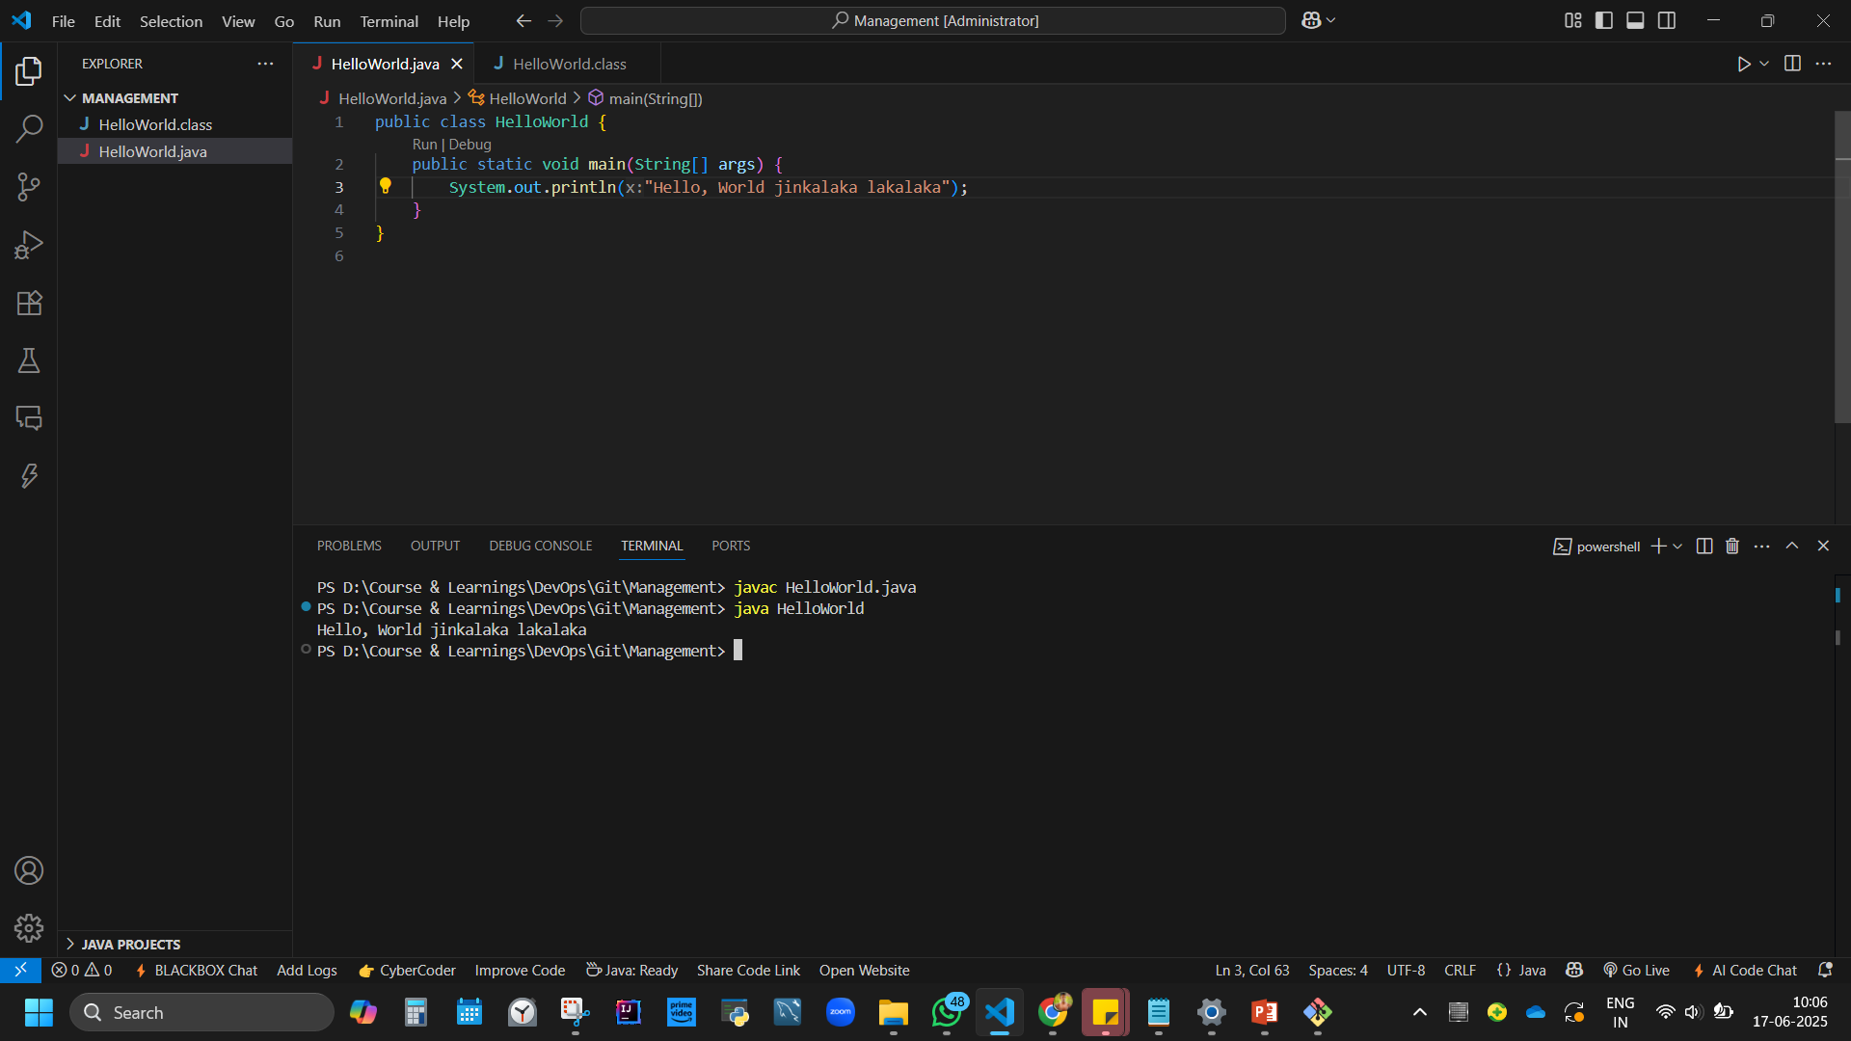

Slide 45
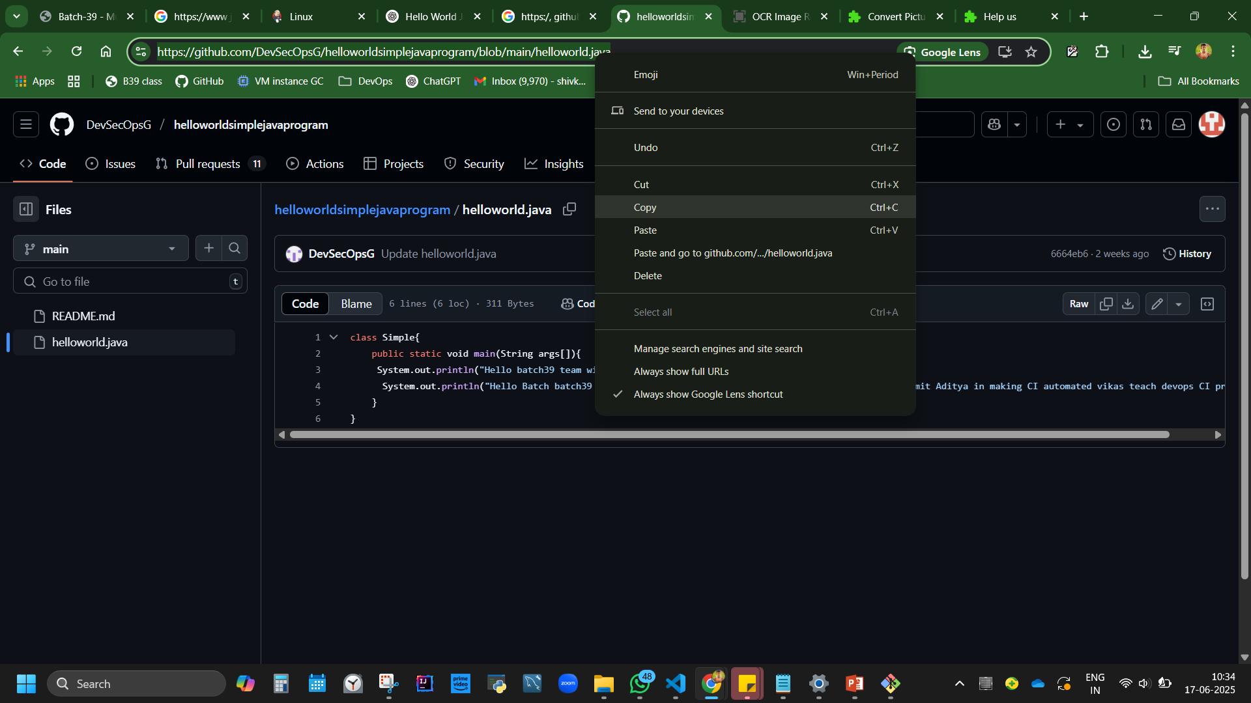
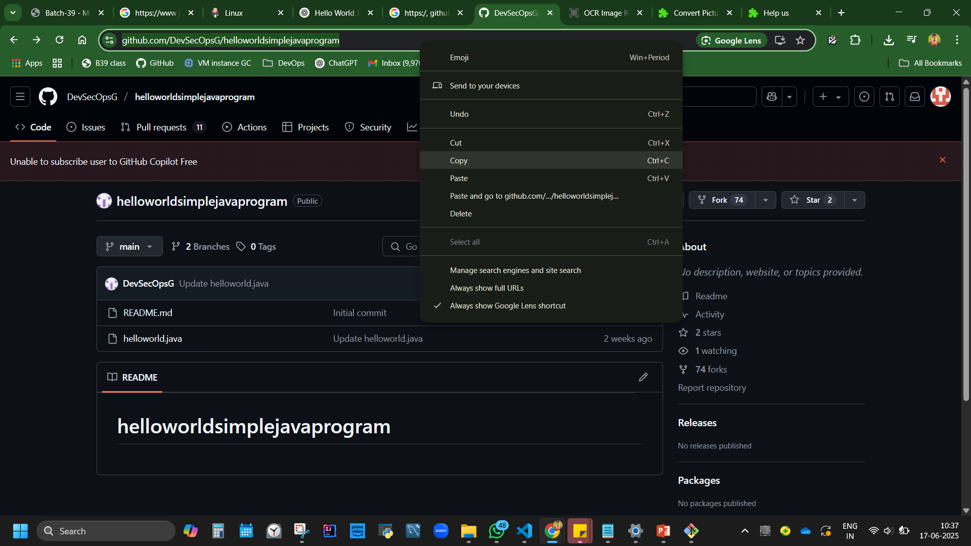

Slide 46
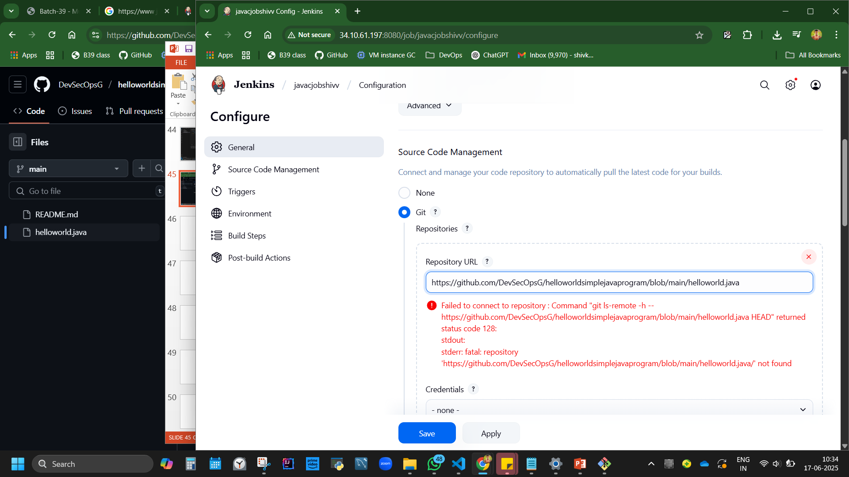
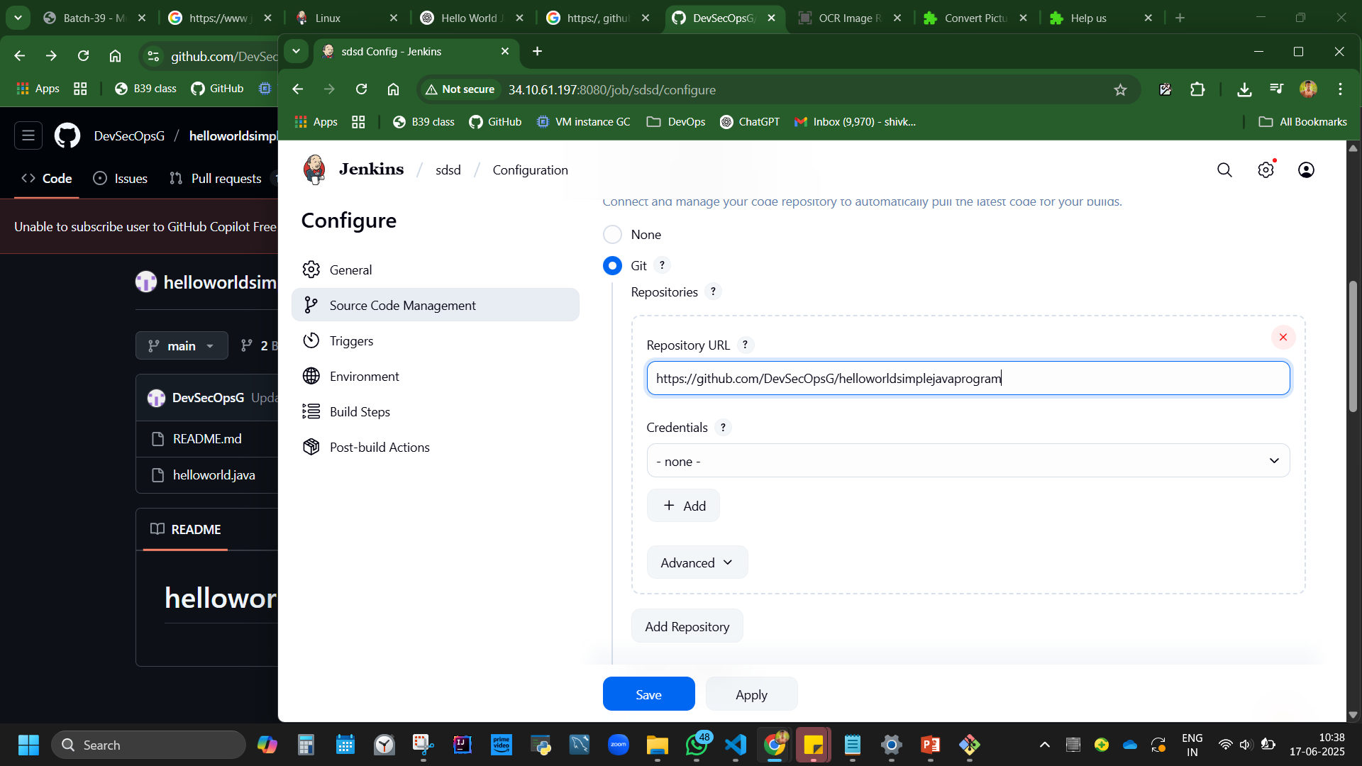

Slide 47
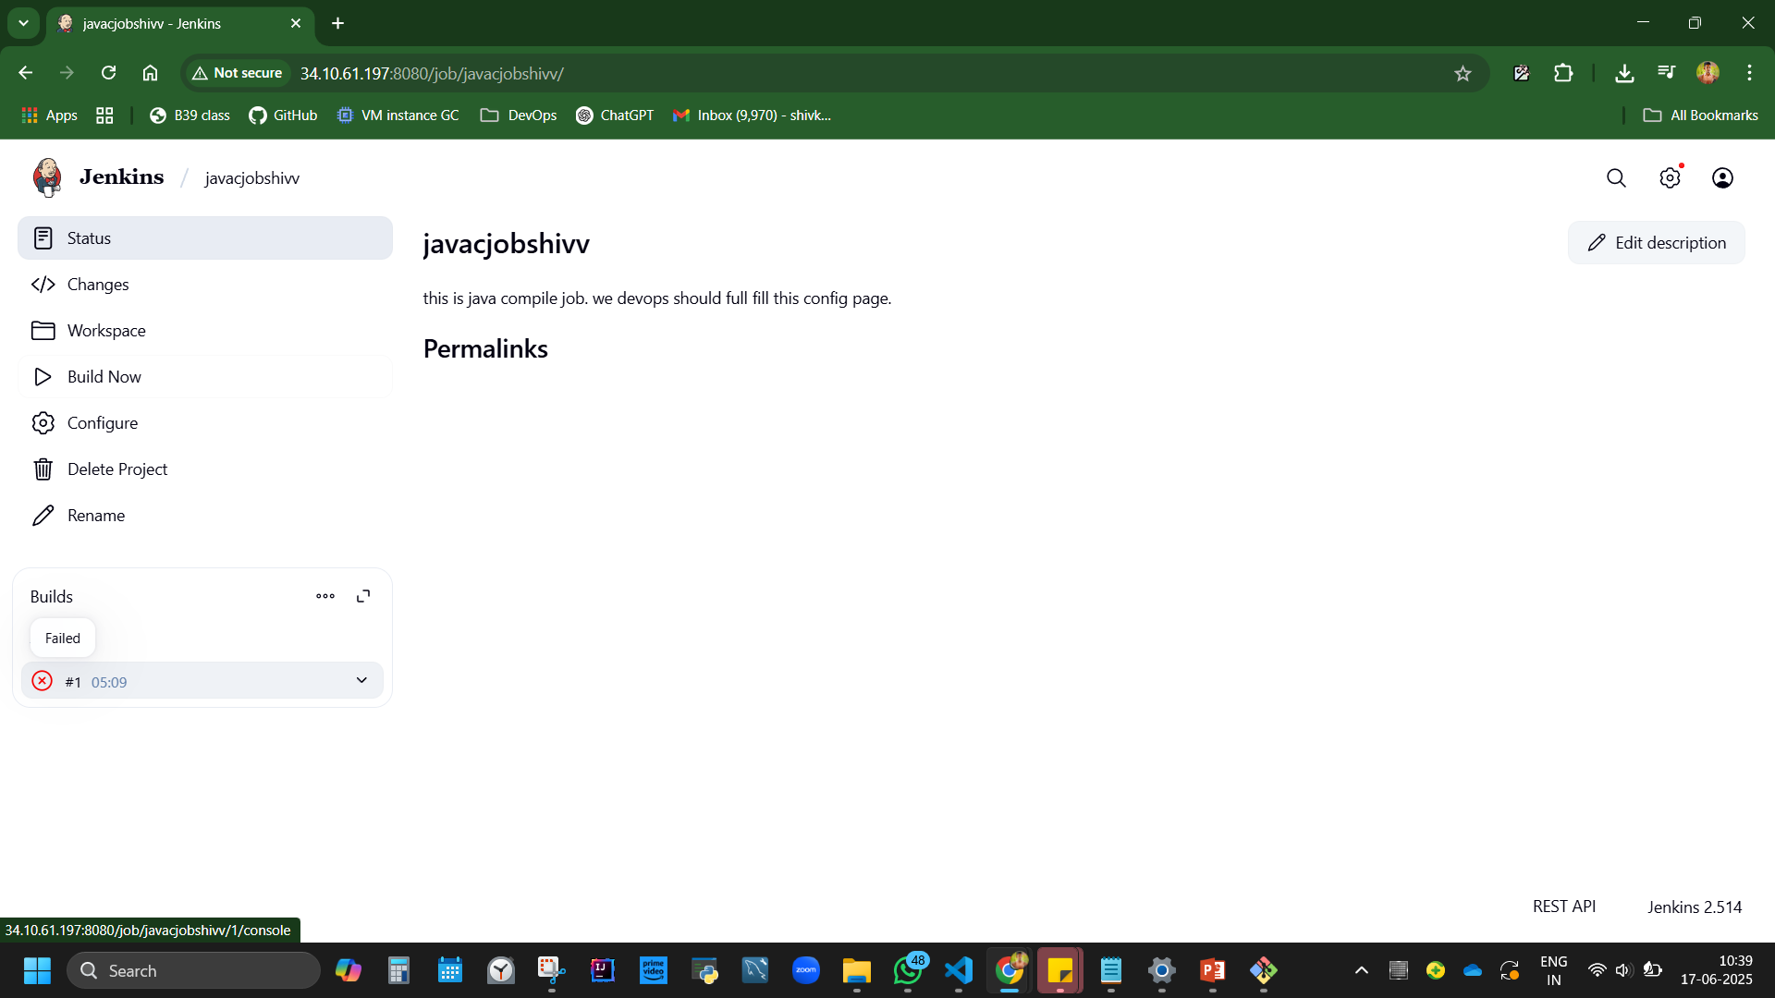
Failed!

Slide 48
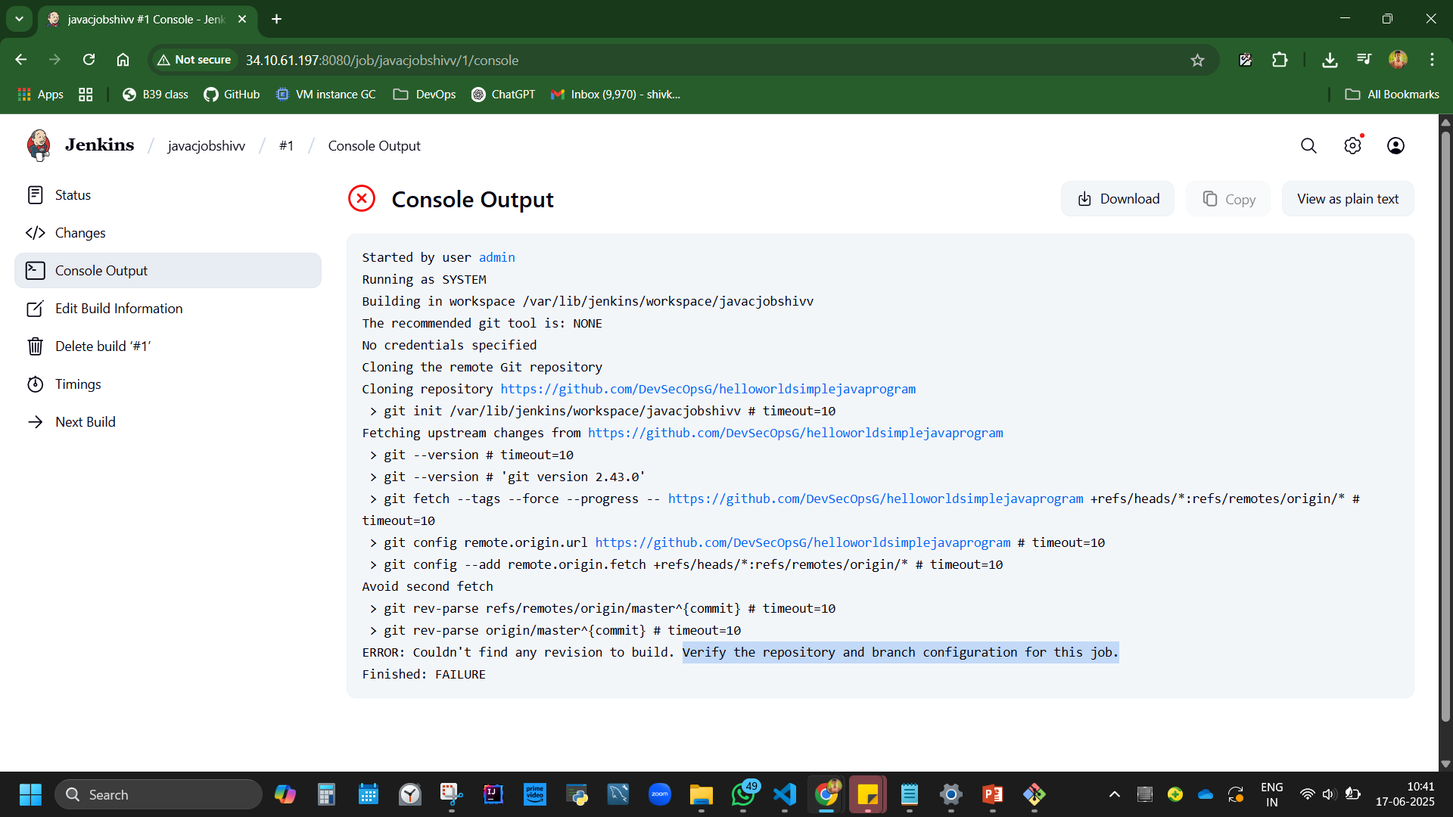

Slide 49
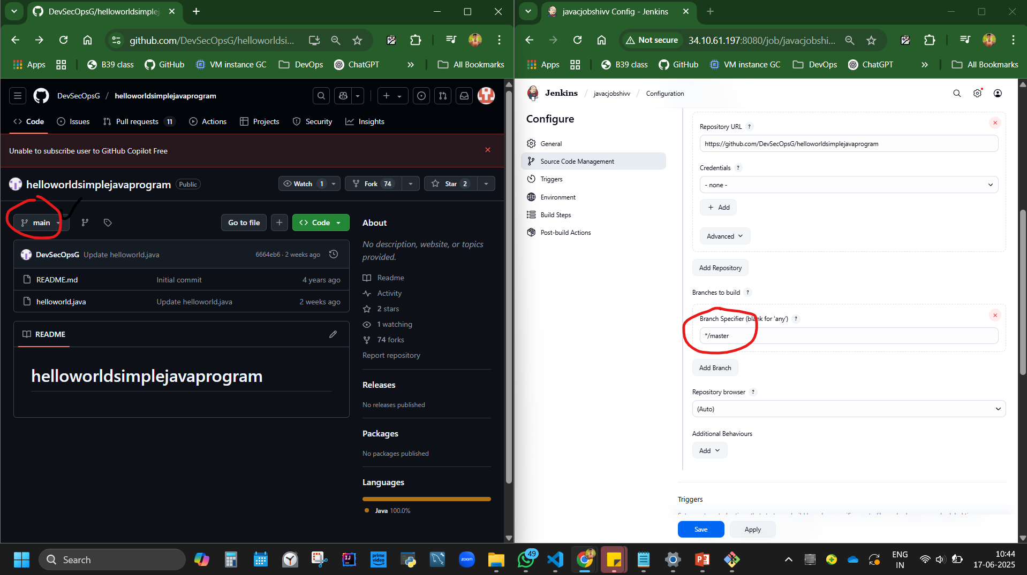
Branch mismatch!

Slide 50
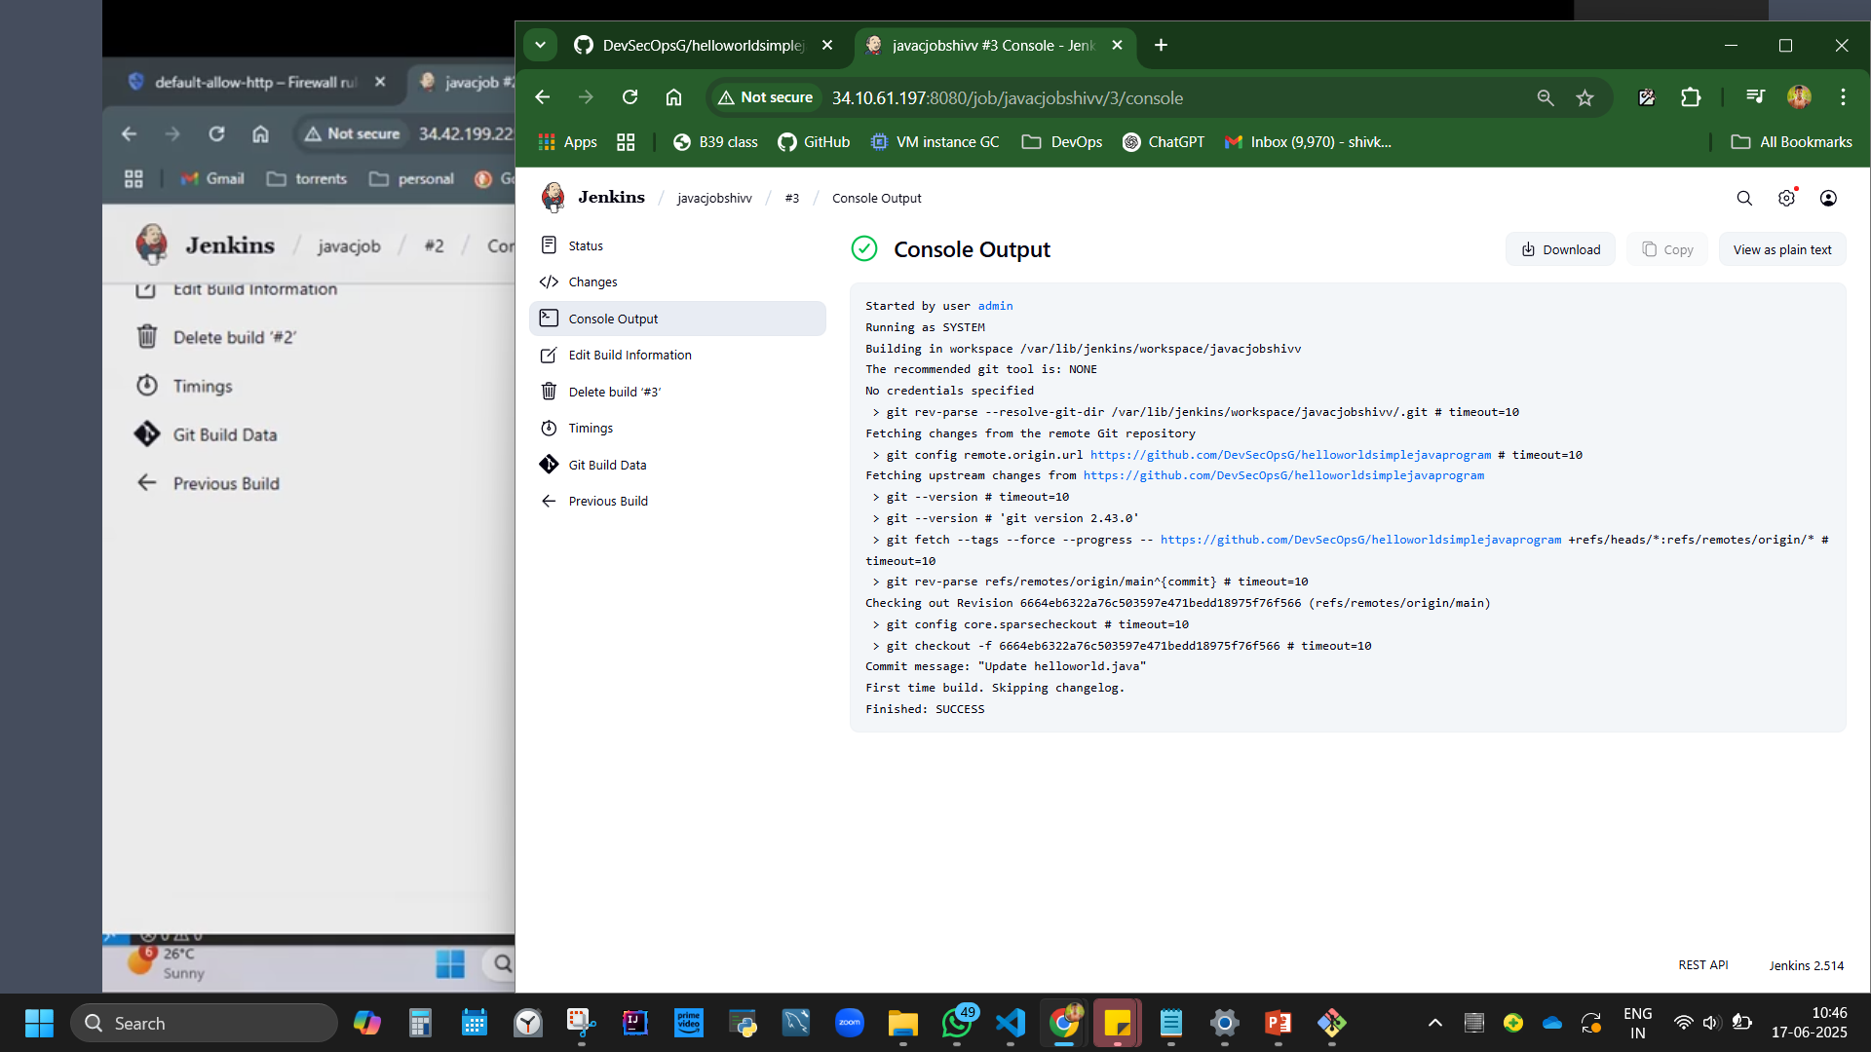
SUCCESS= GITHUB AND JENKIL IS CONNECTED!

Slide 51
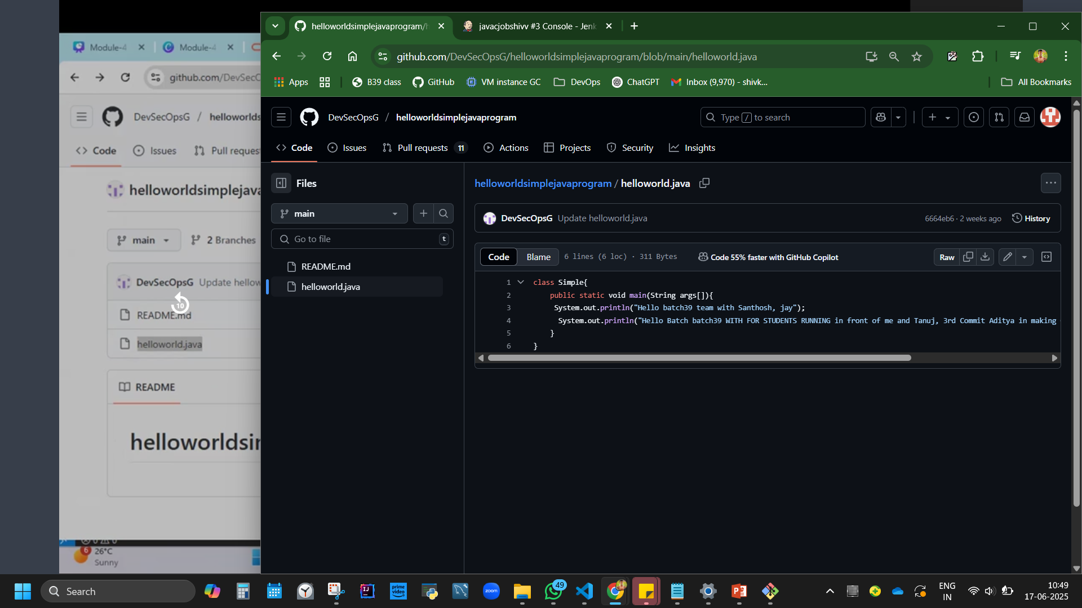
How to compile the git hub code in jenkins?
Javac file name
Java classname
javac helloworld.java
java Simple

Slide 52
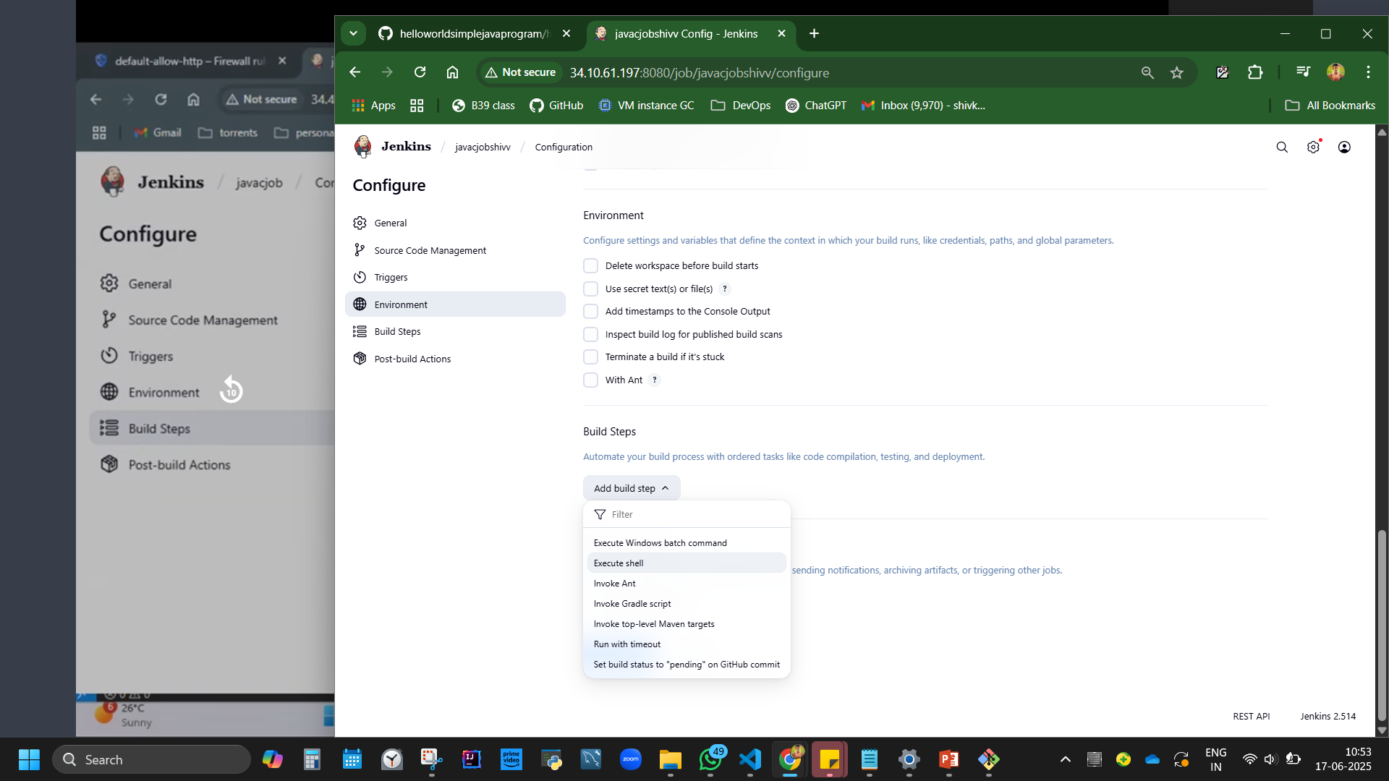

Slide 53
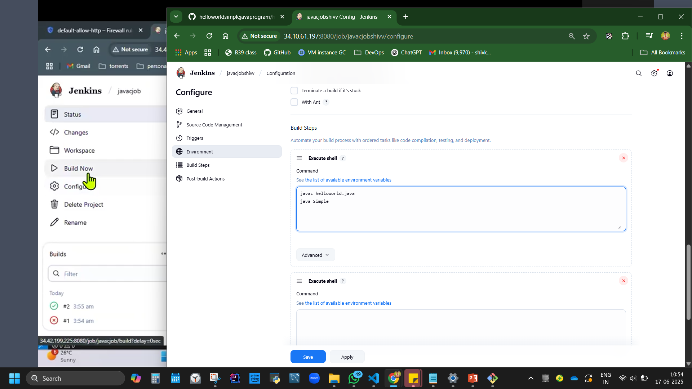

Slide 54
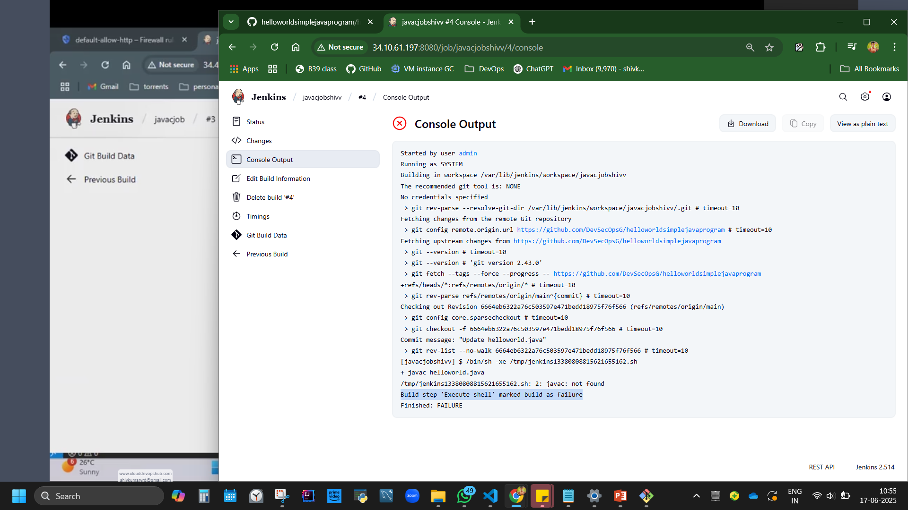
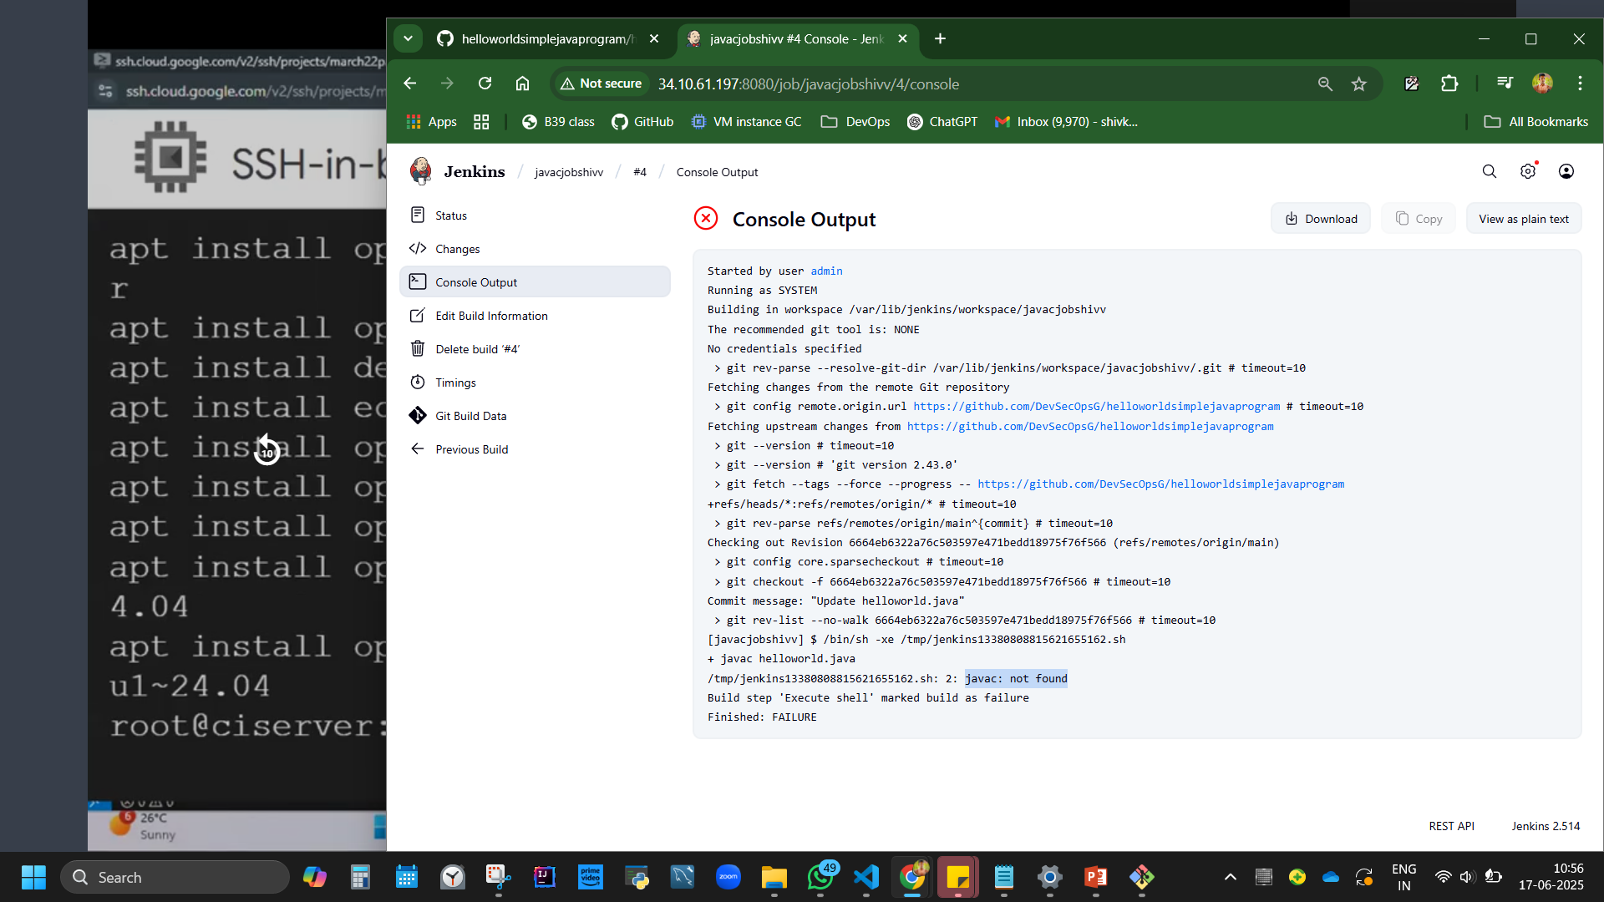
JAVA C NOT FOUND.
(WE HAD INSTALLED JRE “sudo apt install openjdk-17-jre-headless”) SO NOWINSTALL JDK

Slide 55

sudo apt install openjdk-21-jdk -y

Slide 56


https://github.com/DevSecOpsG/helloworldsimplejavaprogram
https://github.com/ShivK8431/helloworldsimplejavaprogram
Change master to main

Slide 57


Slide 58

SET UP CI CONFIG NOW 5MIN

Slide 59

Runs every 5min
* * * *
Do you really mean "every minute" when you say "* * * * *"? Perhaps you meant "H * * * *" to poll once per hour

Slide 60


Slide 61

javac helloworld.java
java Simple

Slide 62


Slide 63

Change some code (as a devops we keep changing codes) in git hub code. We are expected the same to run in Jenkins automatically because of ‘Continous intergration * * *’

Slide 64

2nd build ran automatically, that Is CI

Slide 65


Slide 66


Slide 67
approach 2: jenkin as deveoper/devops - using oracle

Slide 68


Slide 69


Slide 70



Slide 71

password

Slide 73
Creating new Instance with automation/IAAC
Create new instance
machine config ‘name without space and capital L’
OS Ubuntu LTS x86 version
Networking allow trafficking,
Next to create, click on equivalent code
Right side is the google code to create VM instance.,
Run in cloud shell, authorise, another window opens, and VM I created.
Go back, you can see a new VM machine
Creating a machine with the help of console code - With help of CLI, we have g cloud command generated from console for particular version, and when we execute, VM runs.

Slide 74


Slide 75


Slide 76


Slide 77


Slide 78
Connect SSH
apt-get update
apt install docker.io –y
Protip: [if donno the command, just type docker it will suggest the code]
If it doesn’t execute, add sudo
sudo apt-get update
sudo apt install docker.io –y
Info: 🔐 What is sudo?sudo stands for "superuser do".It allows a regular user to run commands with administrative (root) privileges.This is important because some commands — especially those that modify the system (like installing software, updating packages, or changing system configurations) — require elevated permissions for security reasons.
Why do we have to use sudo?When you try to:install a package (apt install),update the system (apt update),or write to protected directories like /var/lib or /etc,you're modifying parts of the system that should only be changed by an administrator.If you're not using sudo, the system will deny access to prevent accidental or malicious changes.
docker --version
Docker version 27.5.1, build 27.5.1-0ubuntu3~24.04.2
shivkumarvrd@shivdocker:~$

Slide 79


Slide 80
docker run -it -d -p 8080:8080 --name jenkins jenkins/jenkins:latest docker ps – see that it is a containerised jenkin
Docker run ~ runs docker jenkin image of latest version
-it ~interactive
-d ~deattached
-p 8080:8080 ~maps VM port with container
--name Jenkins ~Name of container is jenkin
Jenkins/Jenkins
docker ps – see that it is a containerised jenkin
Tip: Use sudo as prefix if access is denied.

Slide 81


Slide 82


Slide 83
cat /var/jenkins_home/secrets/initialAdminPassword
This wont fetch password as we are not in server but in container now
So use
docker exec -it a15397e58418 /bin/bash
Then use
cat /var/jenkins_home/secrets/initialAdminPassword
To obtain password
Note:
exec goes into the container
a15397e58418 is obtained from docker ps code that is container id

Slide 84


Slide 85


Slide 86

http://34.45.111.94:8080/

Slide 87


Jenkins Pipeline

Slide 88


Slide 89
pipeline {
agent any
stages {
stage('Git clone') {
steps {
git branch: 'main', url: 'https://github.com/DevSecOpsG/helloworldsimplejavaprogram'
}
}
stage('Build'){
steps{
sh 'javac helloworld.java'
}
}
stage('Run'){
steps{
sh 'java Simple'
}
}
}
}
New item
Pipeline
Save
Build
git branch: 'main', url: 'https://github.com/ShivK8431/helloworldsimplejavaprogram'

Slide 90


Slide 91
Pipepinename
Pipeline syntax [code will be generated]
Sample step – type what code you are taking from. Ex git
Copy paste repo url (from git hub of hellow world)
Branch master to main
Generate pipeline script
1 pipeline code
git branch: 'main', url: 'https://github.com/ShivK8431/helloworldsimplejavaprogram'

Slide 92


Slide 93

pipeline {
agent any
stages {
stage('Git clone') {
steps {
git branch: 'main', url: 'https://github.com/DevSecOpsG/helloworldsimplejavaprogram'
}
}
stage('Build'){
steps{
sh 'javac helloworld.java'
}
}
stage('Run'){
steps{
sh 'java Simple'
}
}
}
}
git branch: 'main', url: 'https://github.com/ShivK8431/helloworldsimplejavaprogram'

Slide 94
To get ‘step’ part of the code for email feedback
Pipeline name
Pipeline syntax
In Search step search mail
Add to, cc, subject, body

Slide 95


Slide 96


Slide 97
pipeline {
agent any
triggers{
pollSCM(H/5 * * * * *) //Polls SCM every 5 minutes
}
stages {
stage('Git clone') {
steps {
git branch: 'main', url: 'https://github.com/DevSecOpsG/helloworldsimplejavaprogram'
}
}
stage('compile java code'){
steps{
sh 'javac helloworld.java'
}
}
stage('Run the classfile'){
steps{
sh 'java Simple'
}
}
stage('build war file'){
steps{
sh 'mvn package'
}
}
stage('send email'){
steps{
mail bcc: 'rjahnav@amazon.com', body: '''If build fails, deveoper fails, and contact @dev team
POC: vibha''', cc: 'devops@google.com', from: '', replyTo: '', subject: 'Build status', to: 'jyoti@gmail.com'
}
}
}
}
Agent any = takes all
We can use master slave and mention dedicated names

Slide 98
JENKIN installing on end user
https://www.jenkins.io/download/
Install app, test portal 8080, path to java.
Browser localhost:8080 http://localhost:8080/login?from=%2F
Copy paste the red thing in address bar in file explorer. It fetchs the passwordfile, open via notepad, you’ll have password
C:\ProgramData\Jenkins\.jenkins\secrets\initialAdminPassword

Slide 99


Slide 100


Slide 101

https://crontab.guru/#0_8_1_4_2
https://crontab.guru/#0_8_1_4_2

Slide 102


Slide 103


Slide 104

Source code management SCM

Slide 105

Added new node shiv team, but it isn’t connected yet.

Slide 106
Create new node
Dashboard, manage Jenkins, New node, name, permanent, add path in Remote root directory {create a folder in pc, getthat address, add in} save
D:\Course & Learnings\DevOps\Git Week 1 June 2nd\dev

Slide 107



Slide 108
Go to file location, address bar, type cmd open command promt,
From Jenkins, Take 1st file command from Run from agent command line: (Windows)
curl.exe -sO http://localhost:8080/jnlpJars/agent.jar
A jar file agent is downloaded.
Then execute next line command.
Running jar life ‘agent.jar’ connected to url, secret=password, created or shiv team in the given address.
java -jar agent.jar -url http://localhost:8080/ -secret 842b13c69a43cb2fbaa32269f91c88110682746d76893671053a3093d5346572 -name "shiv team" -webSocket -workDir "D:\Course & Learnings\DevOps\Git Week 1 June 2nd\dev"

Slide 109


Slide 110


Slide 111

Connected now

Slide 112

Added a new node ‘performace team’

Slide 113
Click on node, execute 1st and 2nd code in cmd of performance folder in file pc. Node = connected.

Slide 114


Slide 115


Slide 116


Slide 117


Slide 118


Slide 119


New job

Slide 120

https://github.com/ShivK8431/helloworldsimplejavaprogram

Slide 121

Try to build
Fail. Click on fail why?
Check repo – its correct
branch…change from master to main.

Slide 122


Slide 123

Change to main

Slide 124



Slide 125
BACK UP OF JENKINS

Slide 126


